Slide 1
Cos’è il cambiamento climatico?
«Per “cambiamenti climatici” si intendono i cambiamenti a lungo termine delle temperature e dei modelli meteorologici. »
Cit. Nazioni Unite - Centro Regionale di Informazioni
https://unric.org/it/che-cosa-sono-i-cambiamenti-climatici/

Slide 2
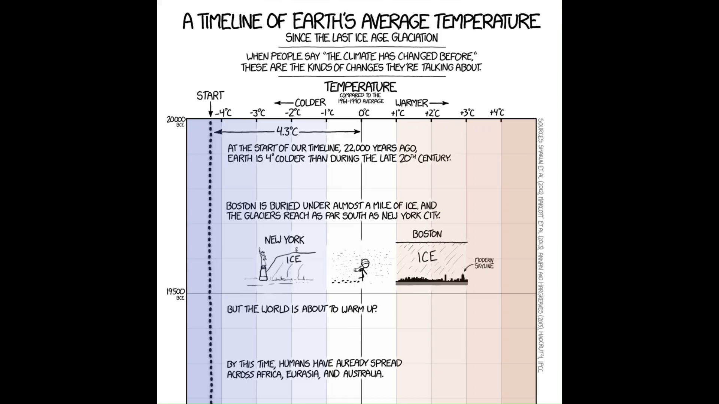
https://xkcd.com/1732/

Slide 3
🖼️ Framework scientifico
📩 Reperire i dati
⚙️ Analizzare i dati
🗺️ Visualizzare i risultati
🤔 Interrogarsi sui risultati

Slide 4
🖼️

Slide 5
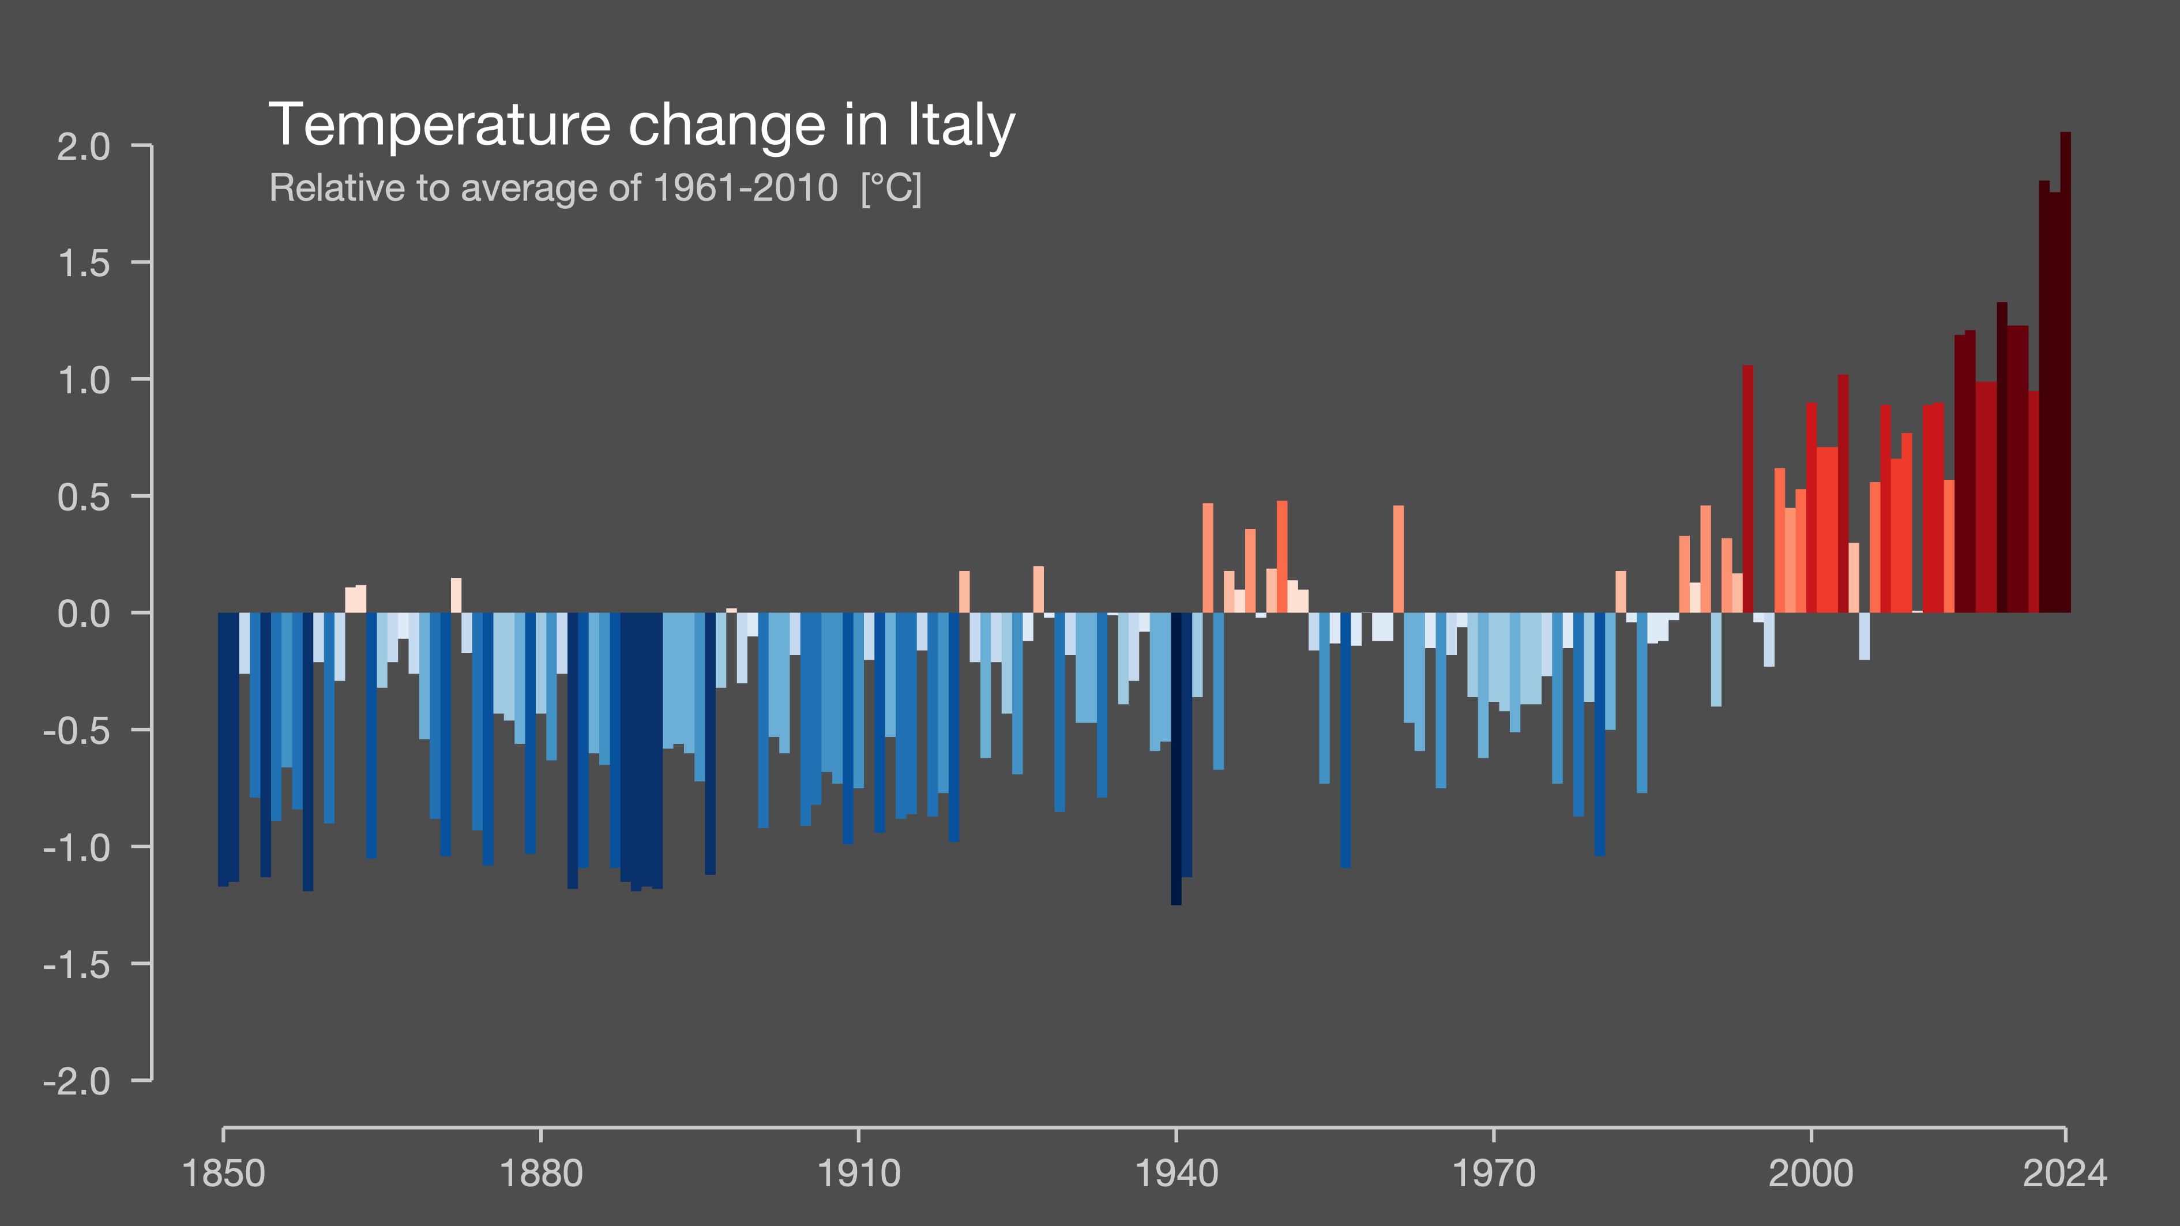
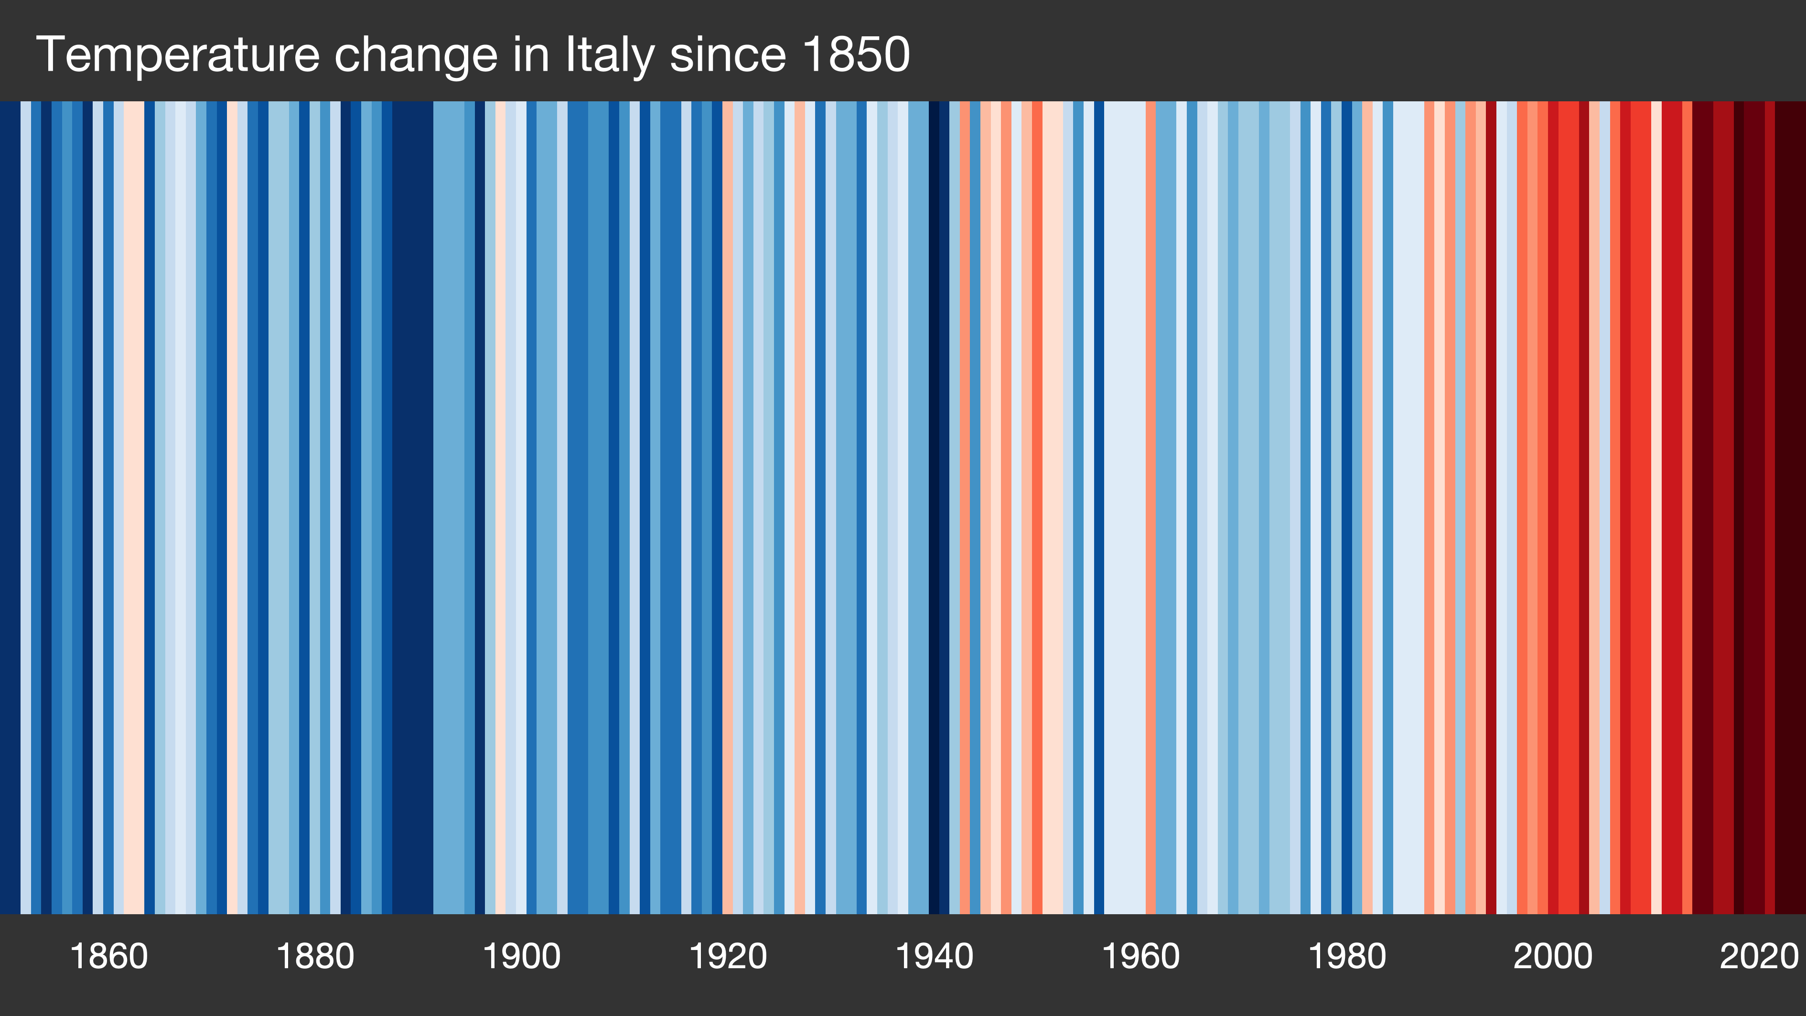
Showyourstripes.info by Ed Hawkins, University of Reading

Slide 6

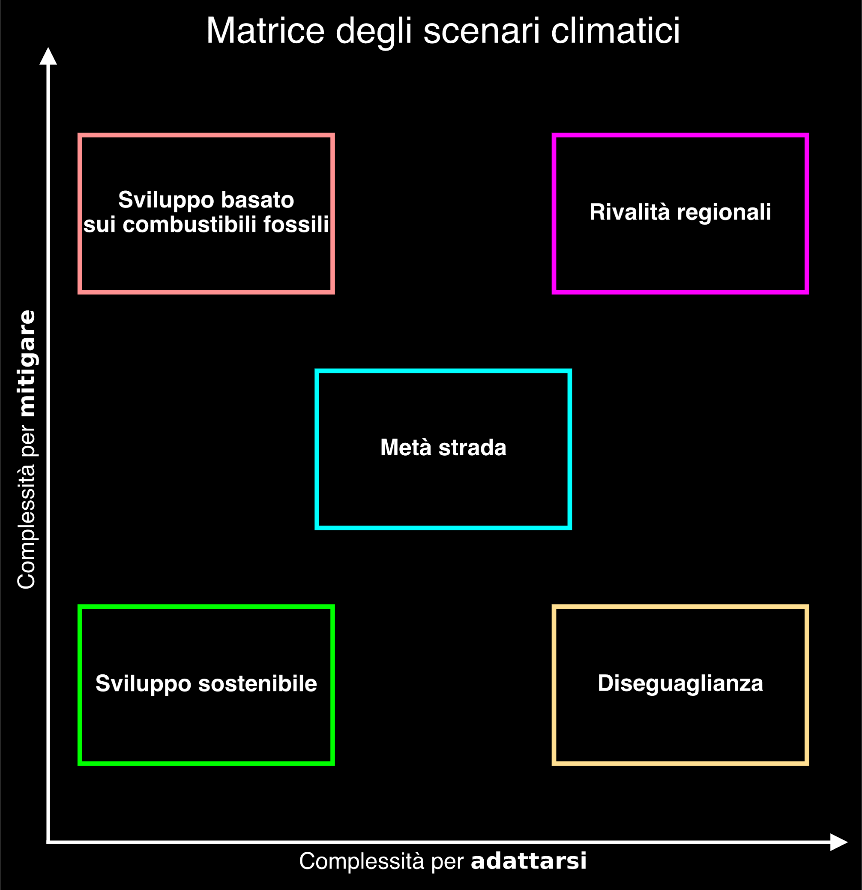

Slide 7
📩

Slide 8
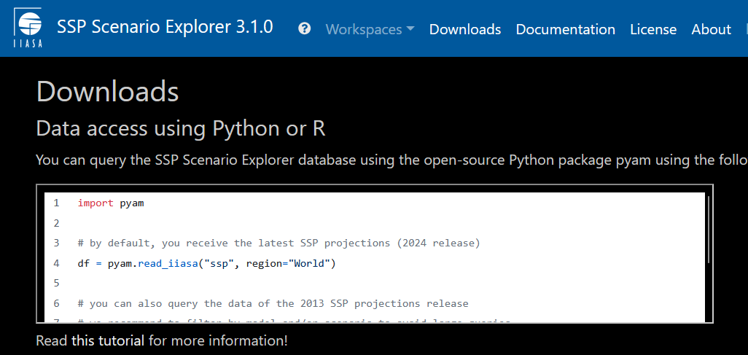

https://data.ece.iiasa.ac.at/ssp/#/downloads
© IIASA and contributing modeling teams 2024

Slide 9


Slide 11
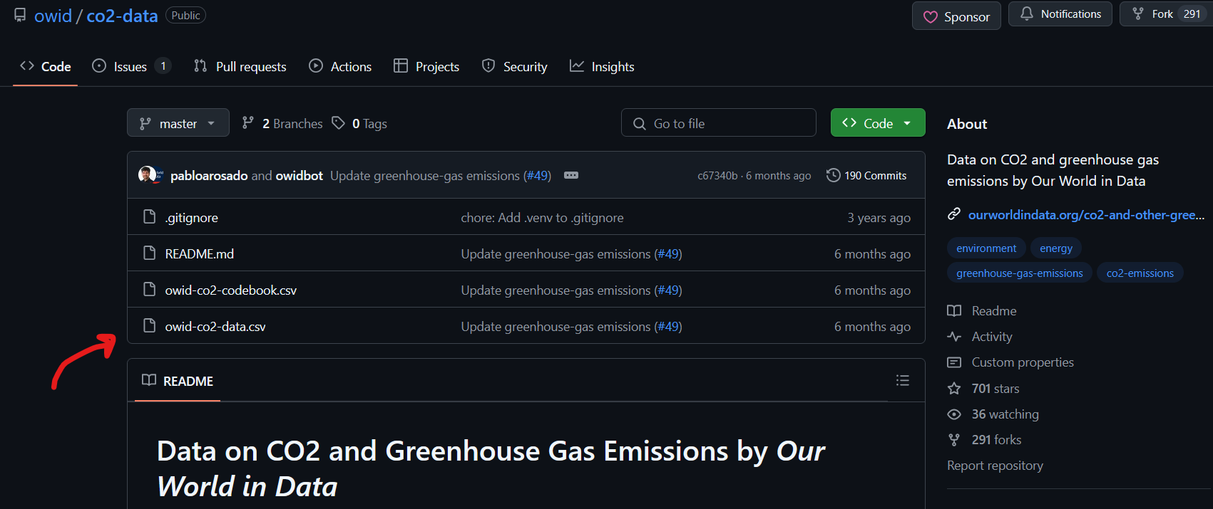
https://github.com/owid/co2-data
Hannah Ritchie, Pablo Rosado, and Max Roser (2023) - “CO₂ and Greenhouse Gas Emissions” Published online at OurWorldinData.org. Retrieved from: 'https://ourworldindata.org/co2-and-greenhouse-gas-emissions' [Online Resource]

Slide 13


Slide 14
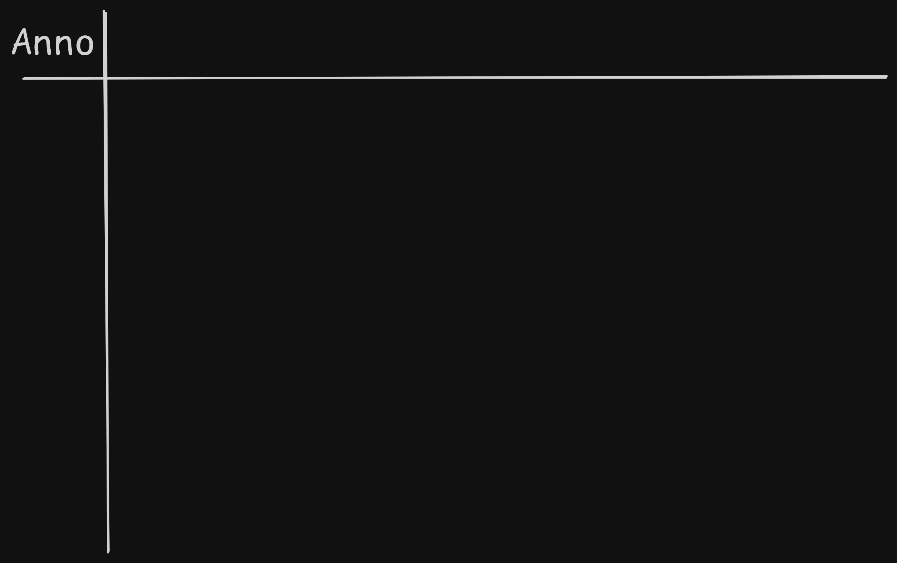

Slide 15
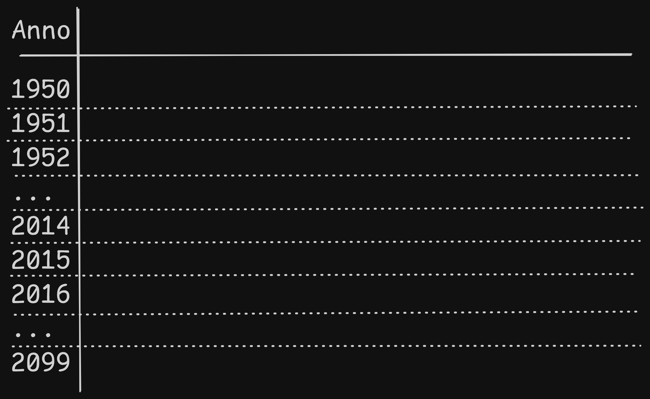

Slide 16
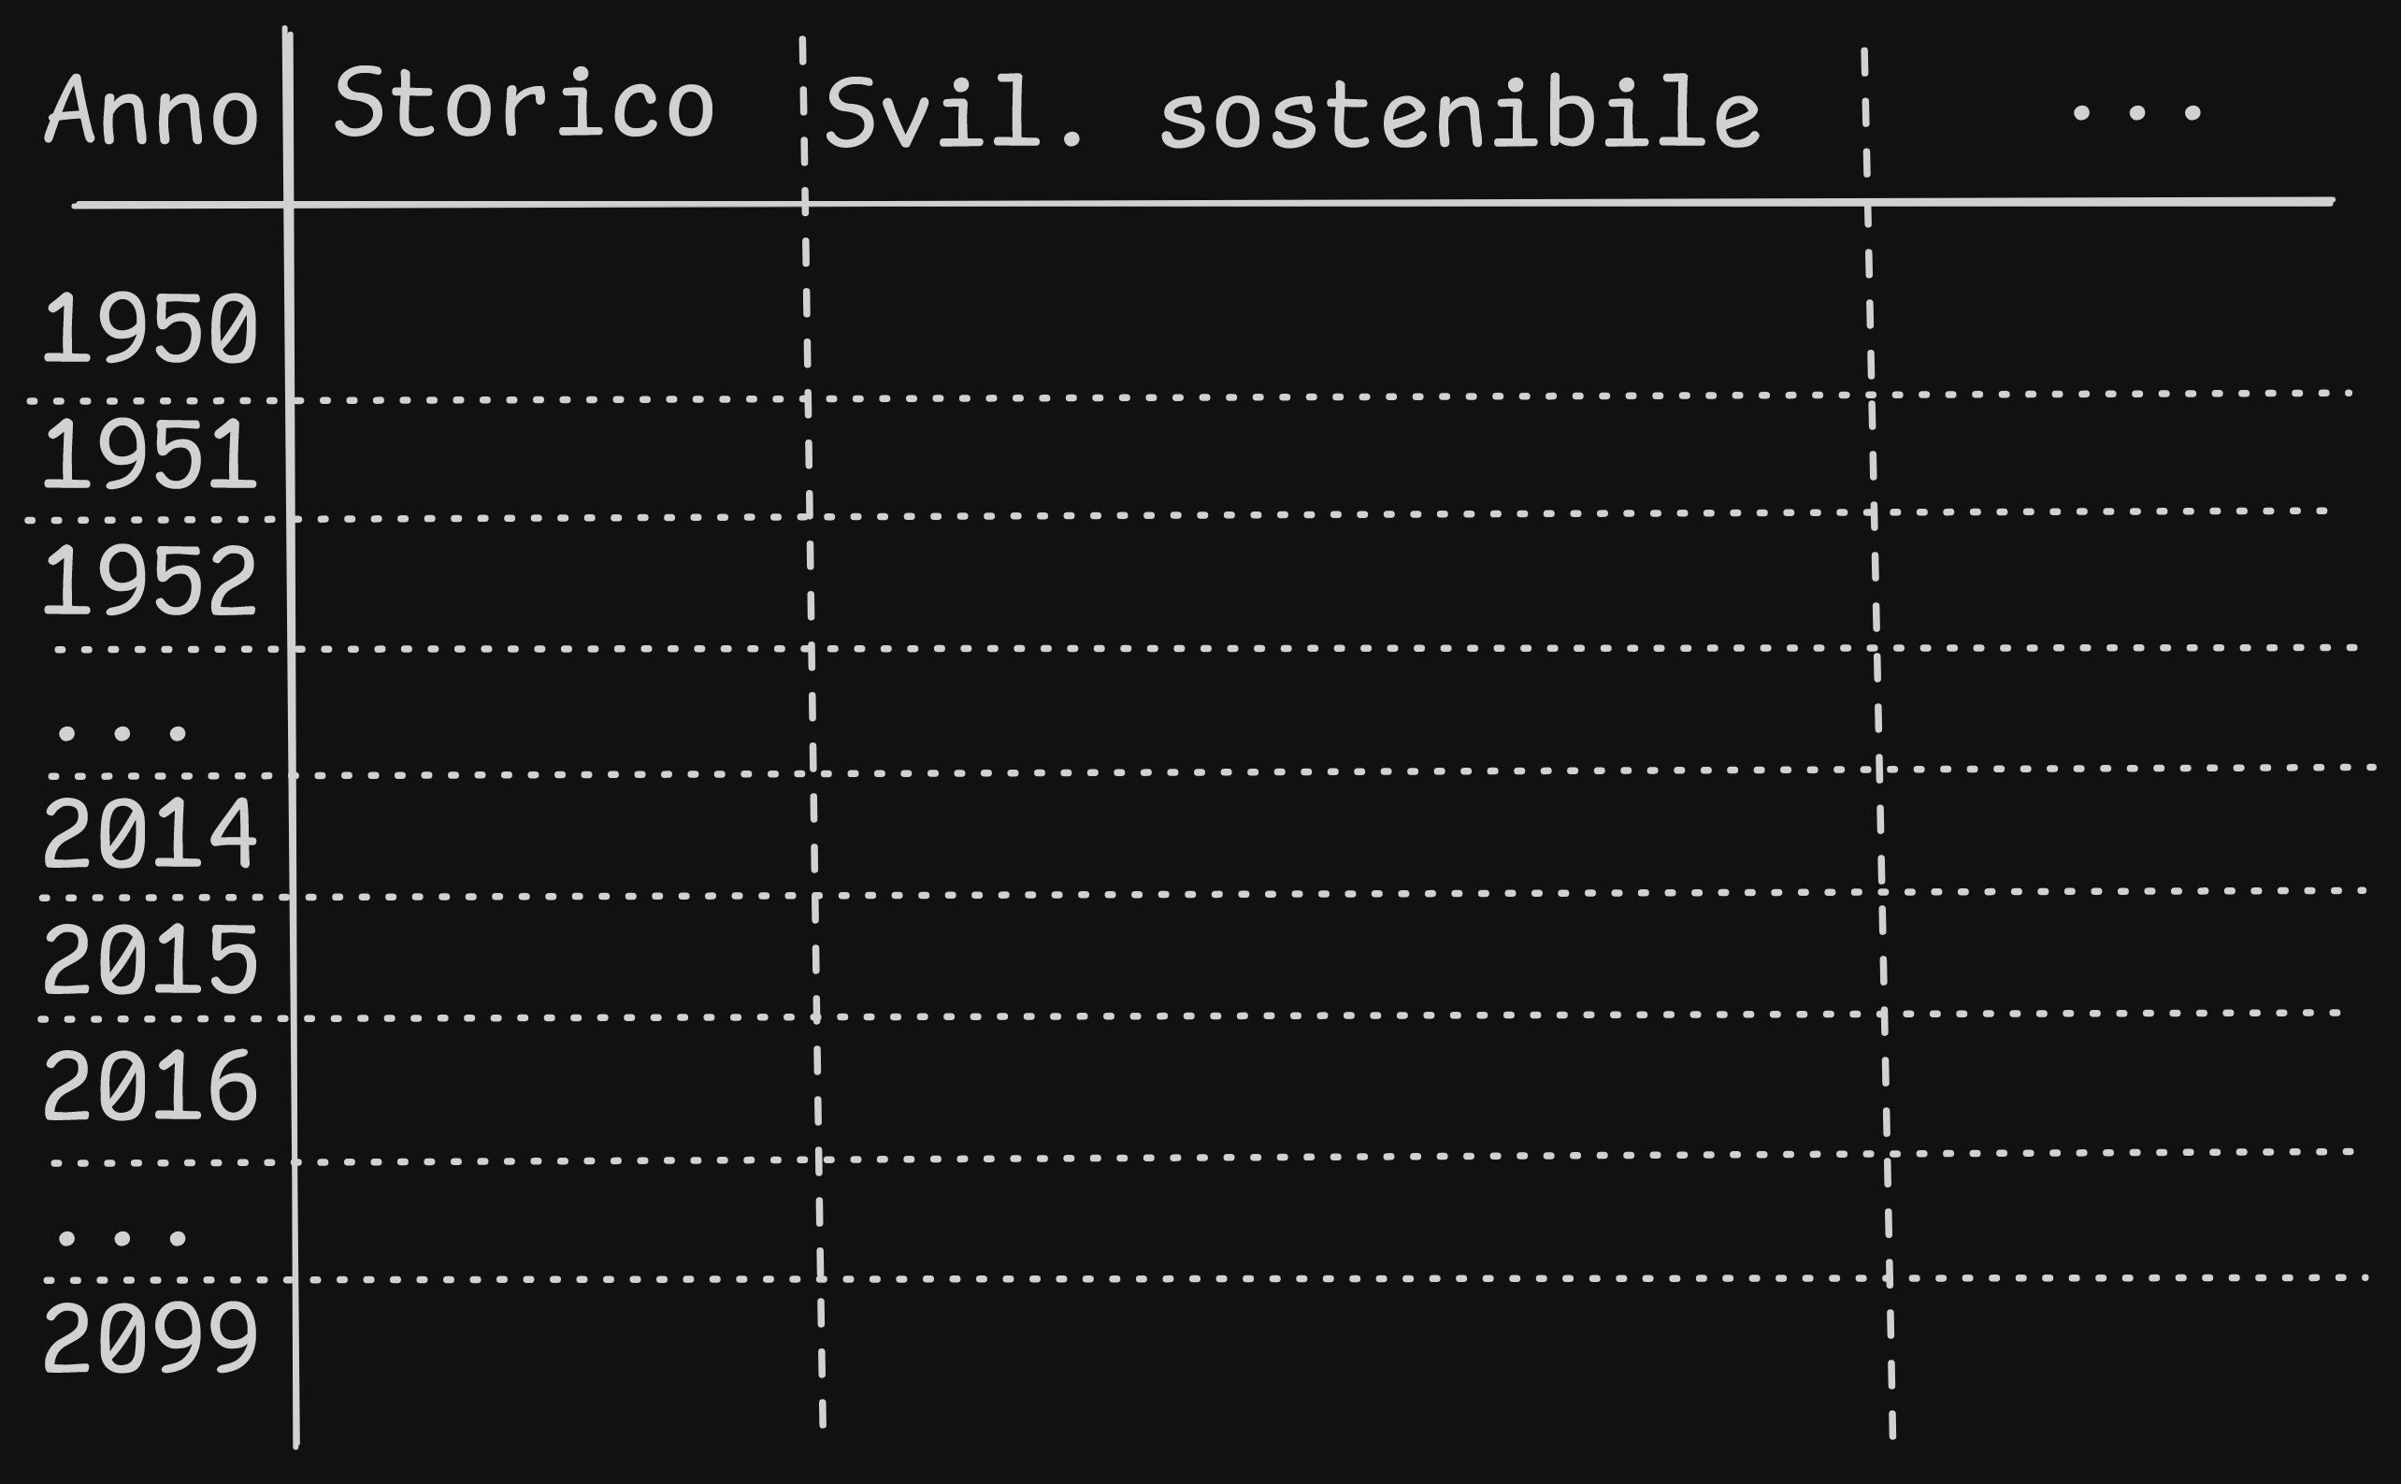

Slide 17
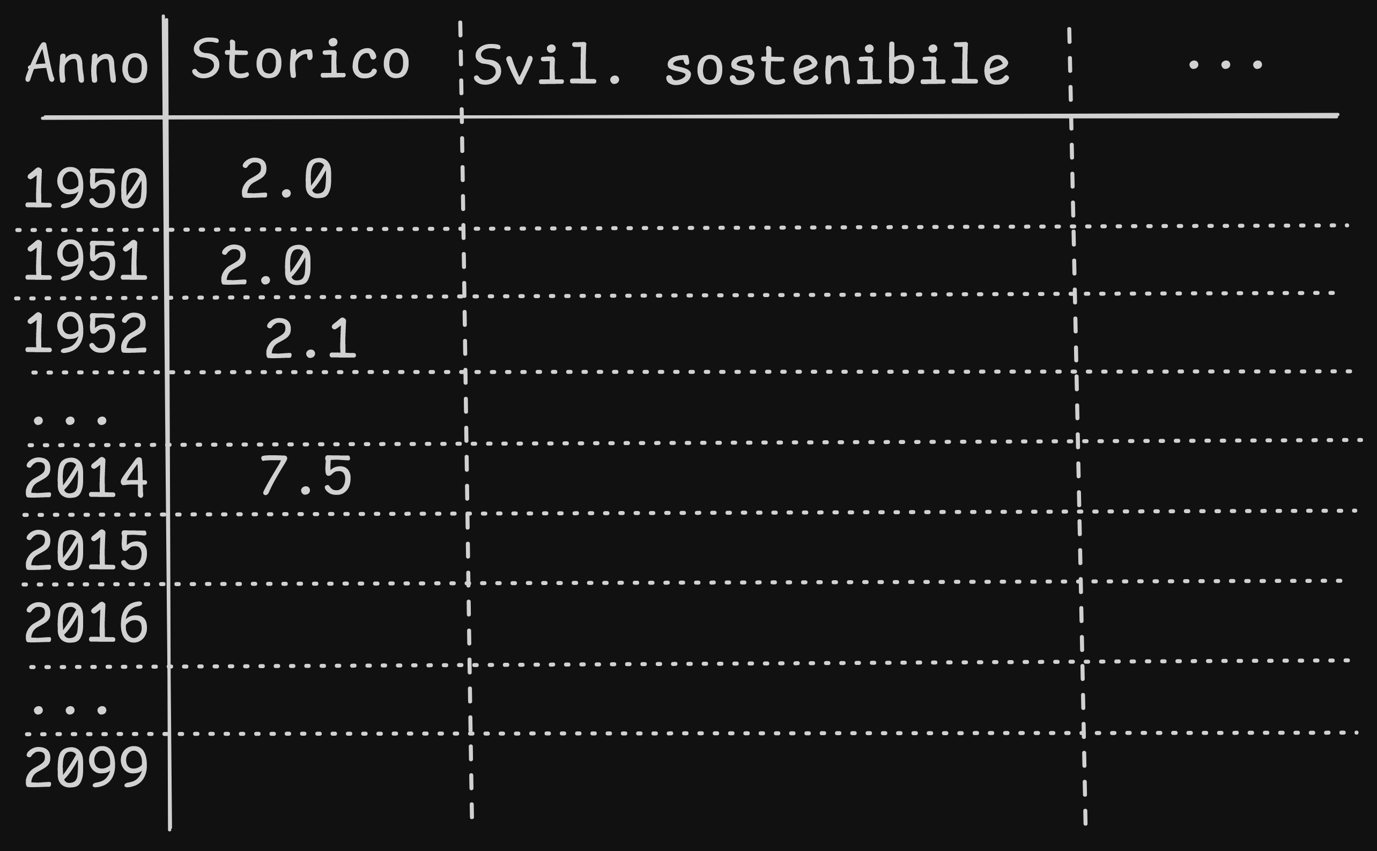

Slide 18
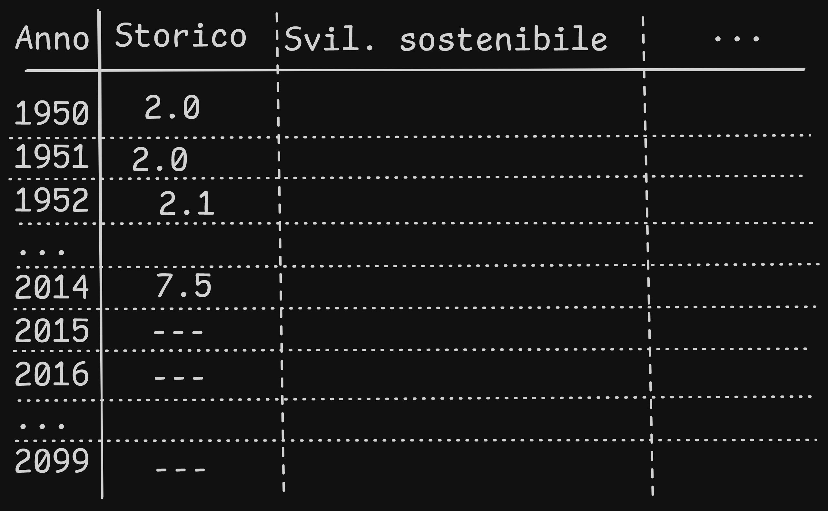

Slide 19
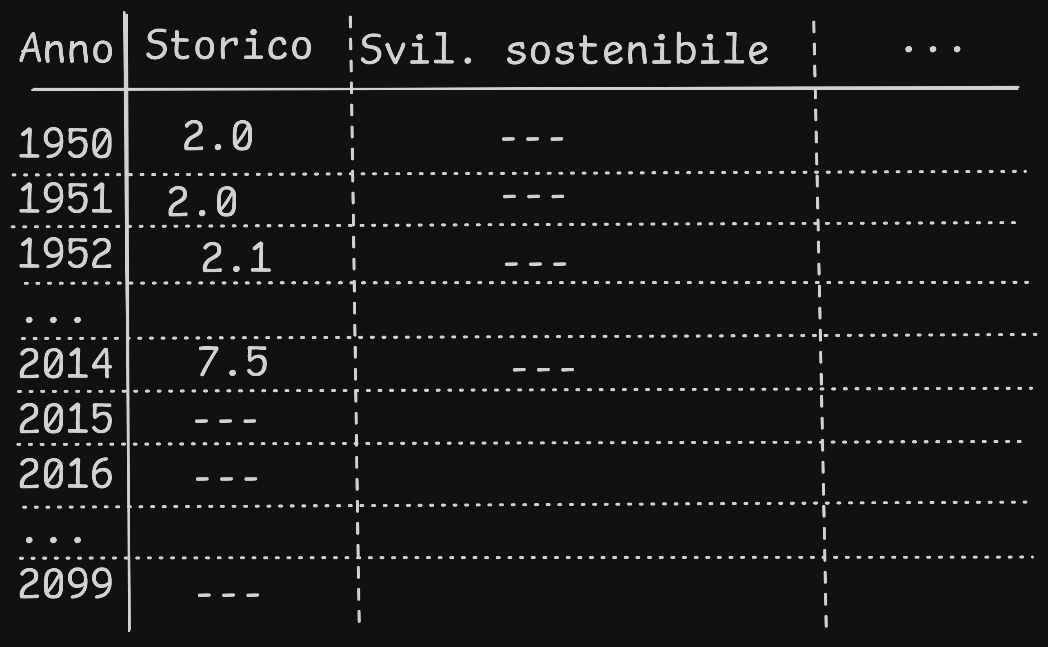

Slide 20
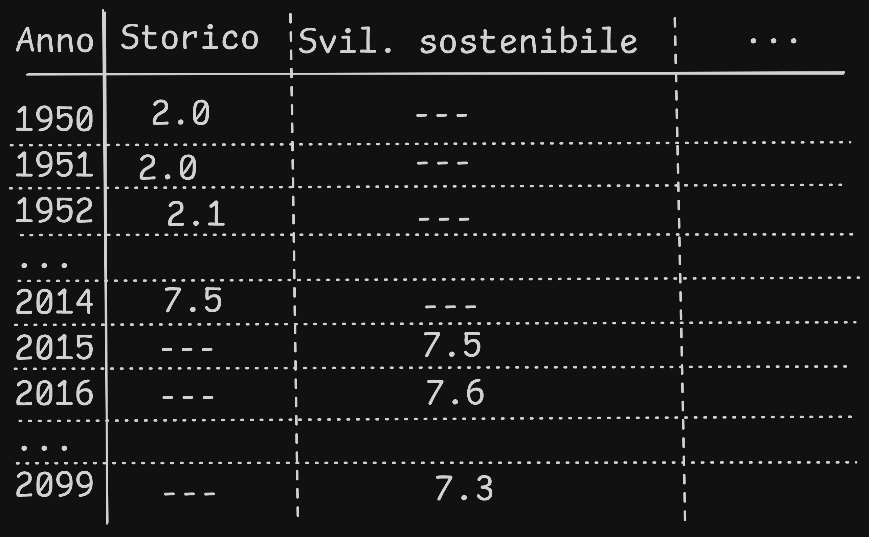
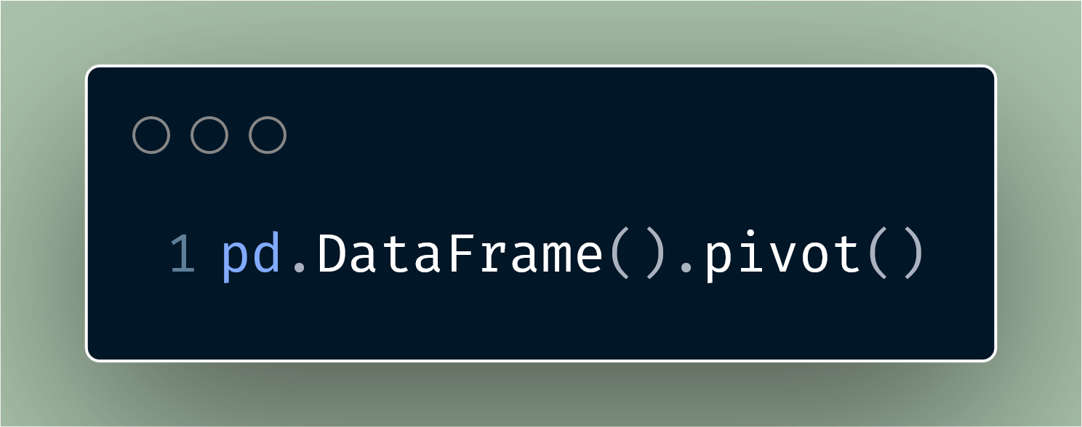

Slide 21
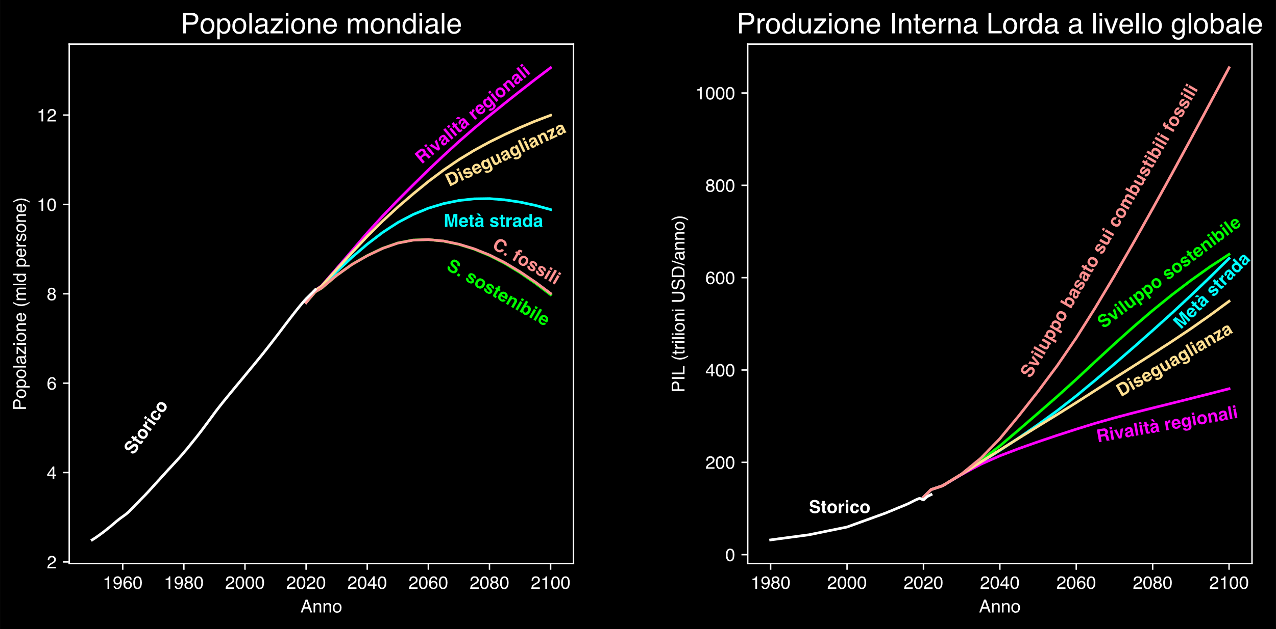

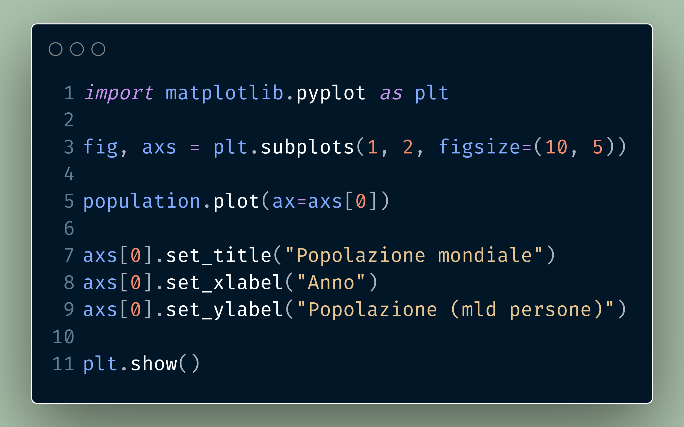
Hannah Ritchie, Pablo Rosado, and Max Roser (2023) - “CO₂ and Greenhouse Gas Emissions” Published online at OurWorldinData.org. Retrieved from: 'https://ourworldindata.org/co2-and-greenhouse-gas-emissions' [Online Resource]
© IIASA and contributing modeling teams 2024
K. Riahi et al.,

Slide 22
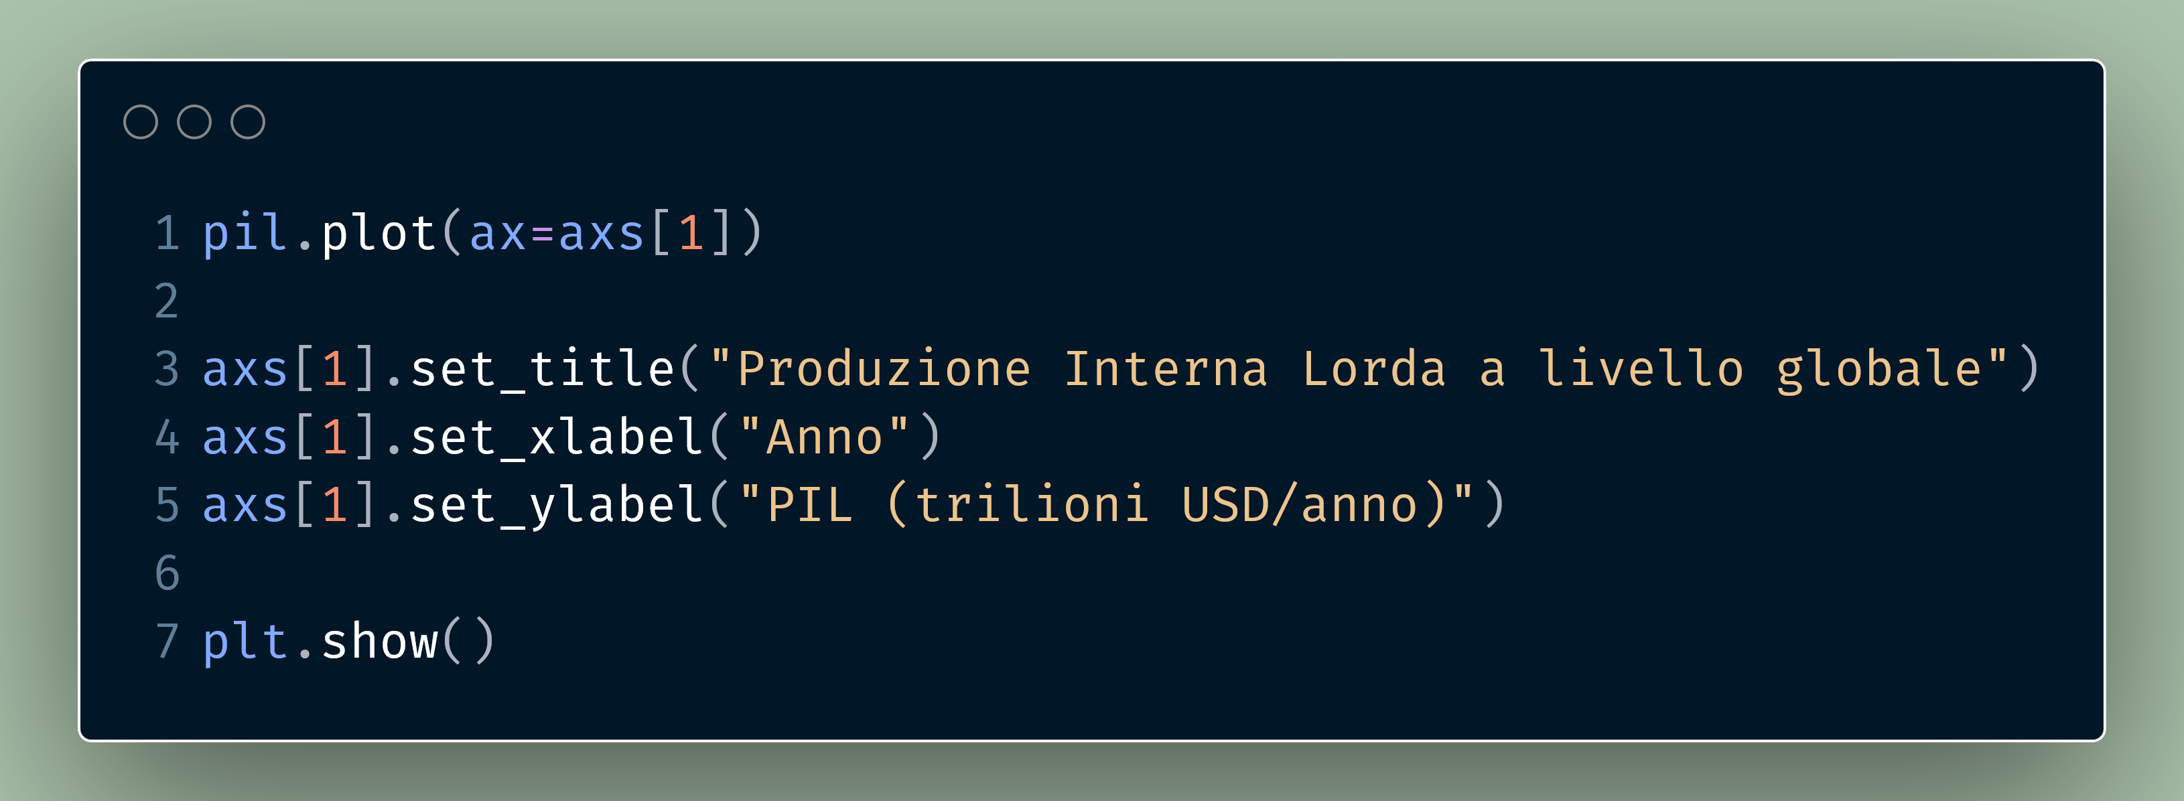
Hannah Ritchie, Pablo Rosado, and Max Roser (2023) - “CO₂ and Greenhouse Gas Emissions” Published online at OurWorldinData.org. Retrieved from: 'https://ourworldindata.org/co2-and-greenhouse-gas-emissions' [Online Resource]
© IIASA and contributing modeling teams 2024
K. Riahi et al.,

Slide 23
Hannah Ritchie, Pablo Rosado, and Max Roser (2023) - “CO₂ and Greenhouse Gas Emissions” Published online at OurWorldinData.org. Retrieved from: 'https://ourworldindata.org/co2-and-greenhouse-gas-emissions' [Online Resource]
© IIASA and contributing modeling teams 2024
K. Riahi et al.,

Slide 24
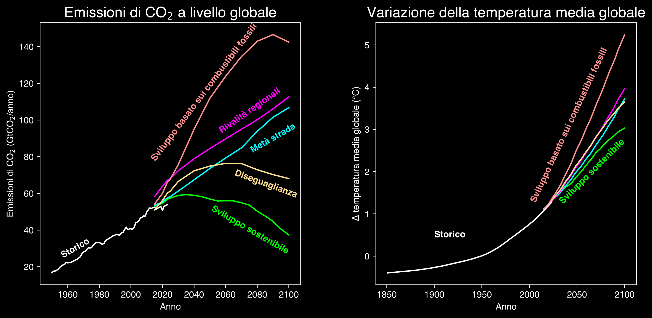
Hannah Ritchie, Pablo Rosado, and Max Roser (2023) - “CO₂ and Greenhouse Gas Emissions” Published online at OurWorldinData.org. Retrieved from: 'https://ourworldindata.org/co2-and-greenhouse-gas-emissions' [Online Resource]
© IIASA and contributing modeling teams 2024
K. Riahi et al.,

Slide 25
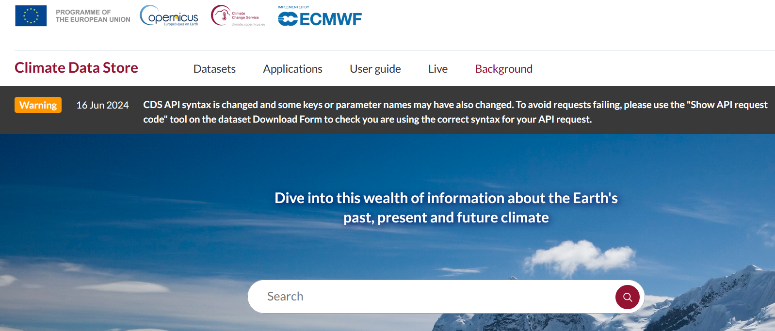
https://cds.climate.copernicus.eu/

Slide 26
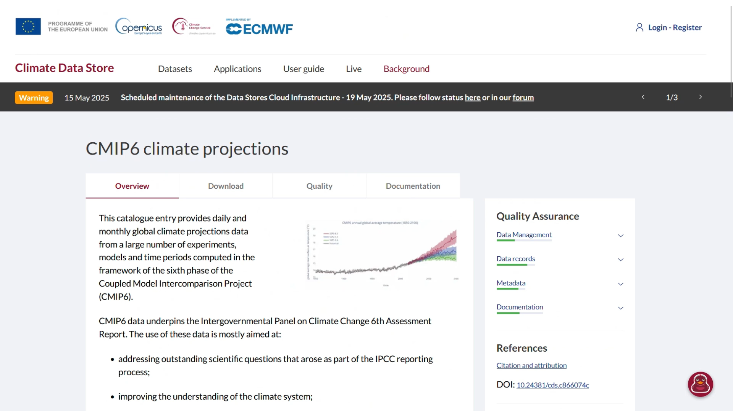

Slide 27
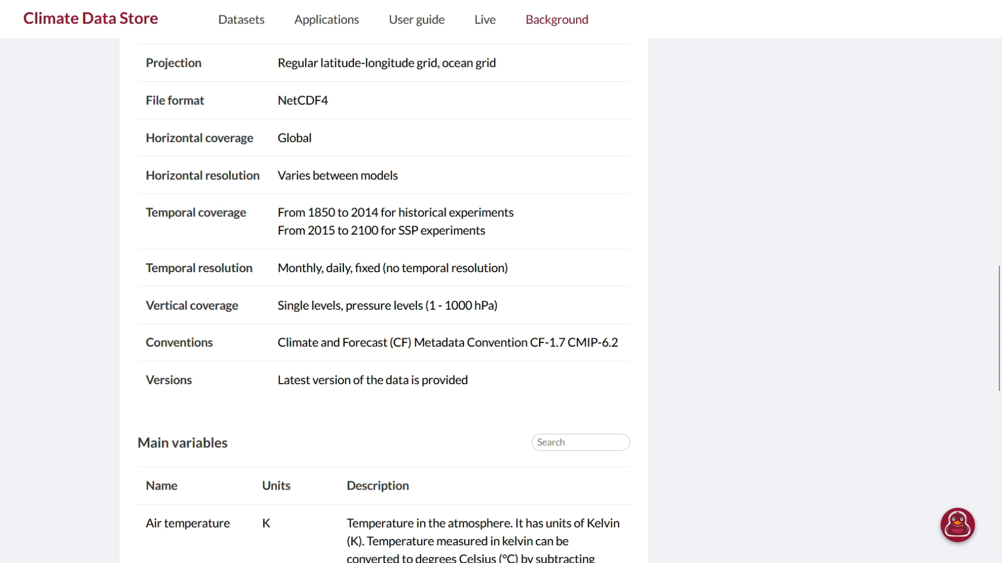

Slide 28
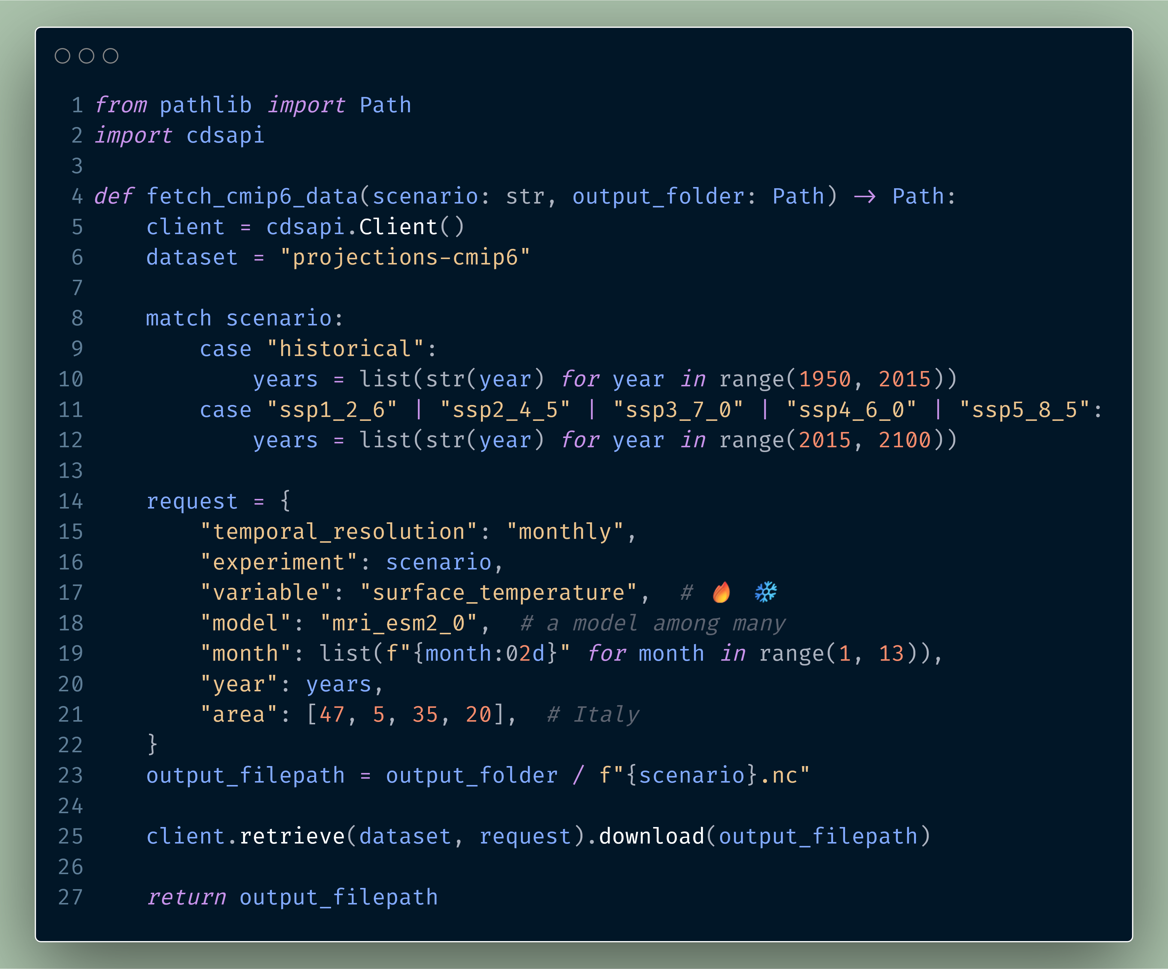

Slide 30
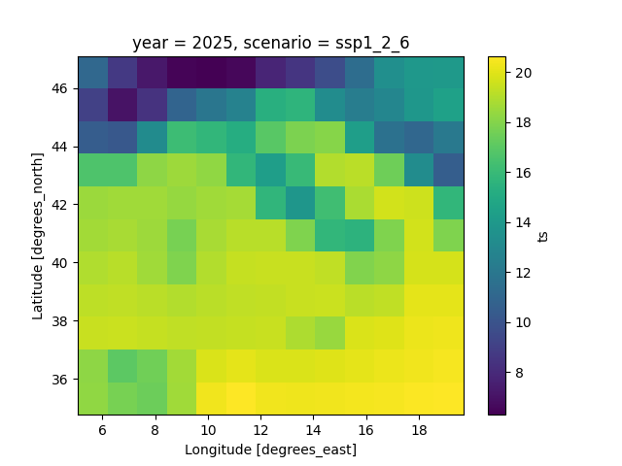
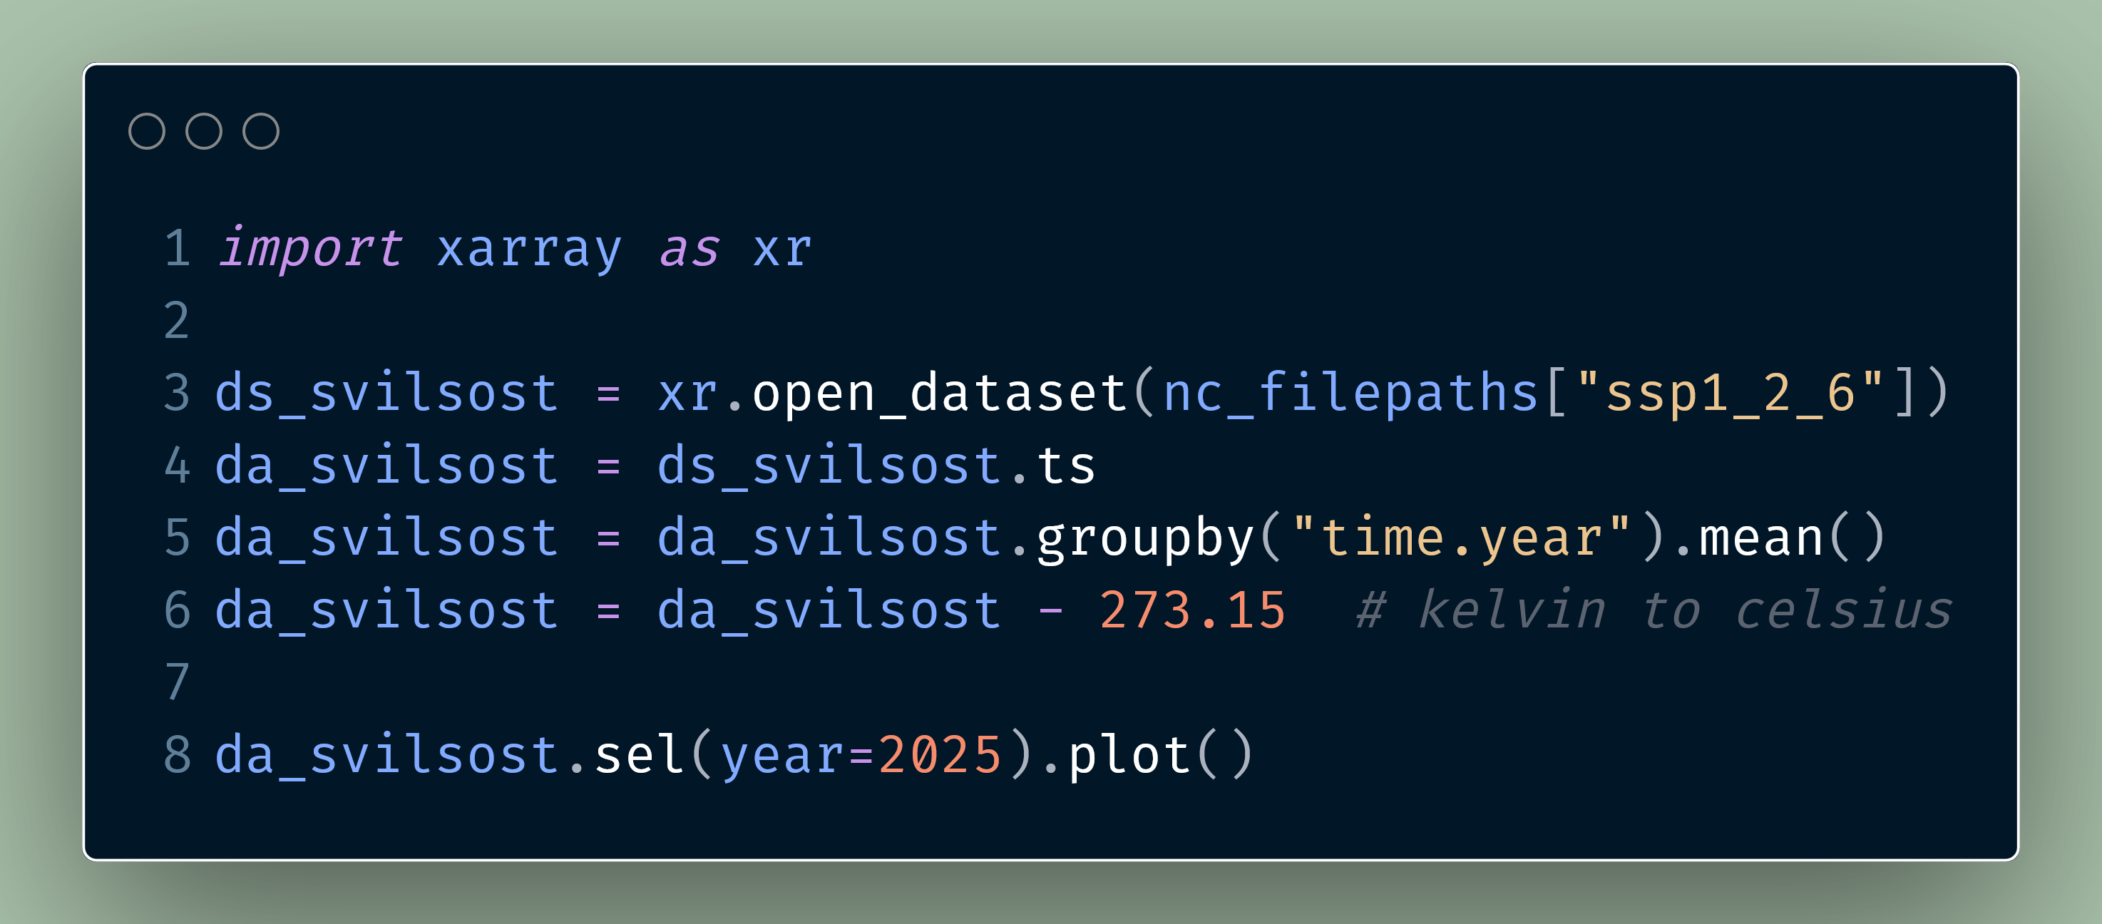


Slide 31
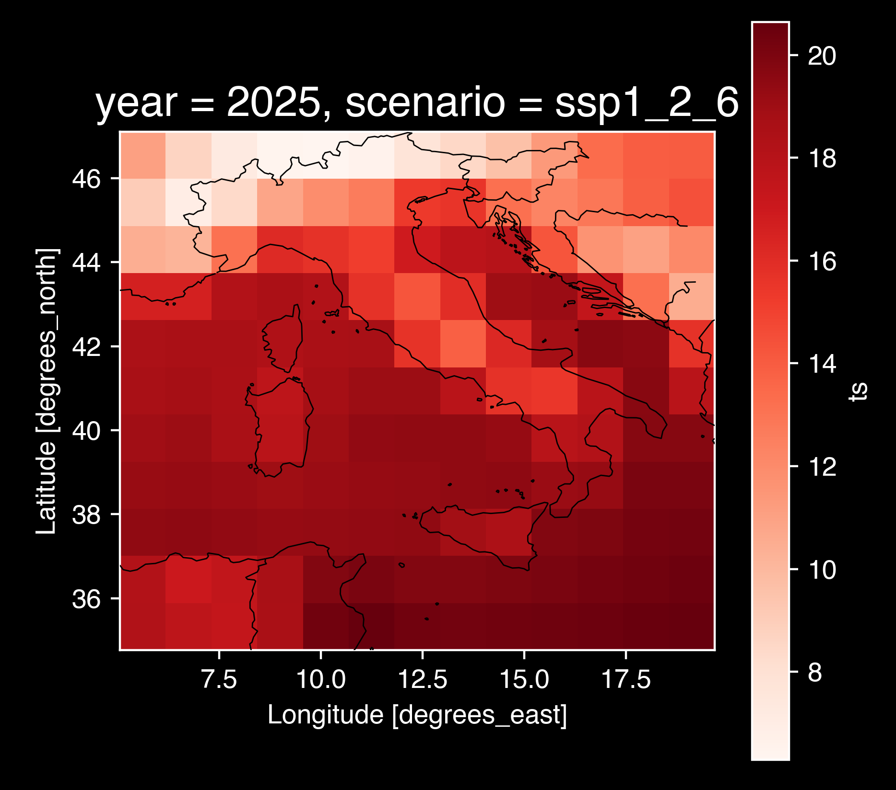

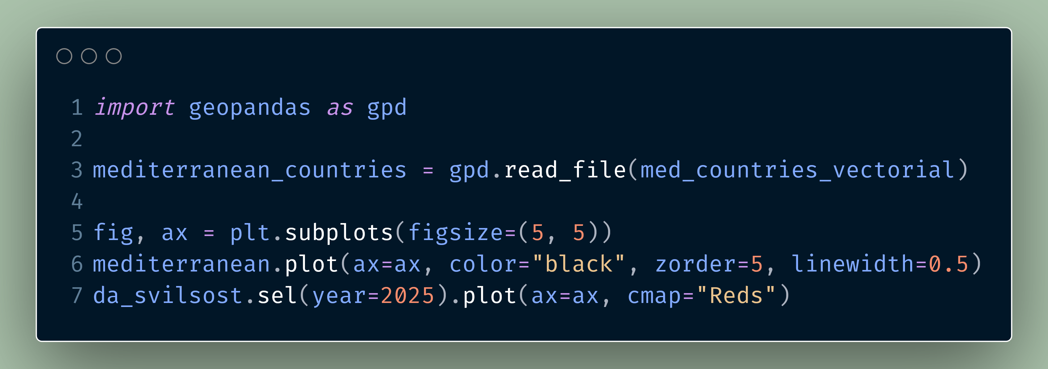

Slide 32
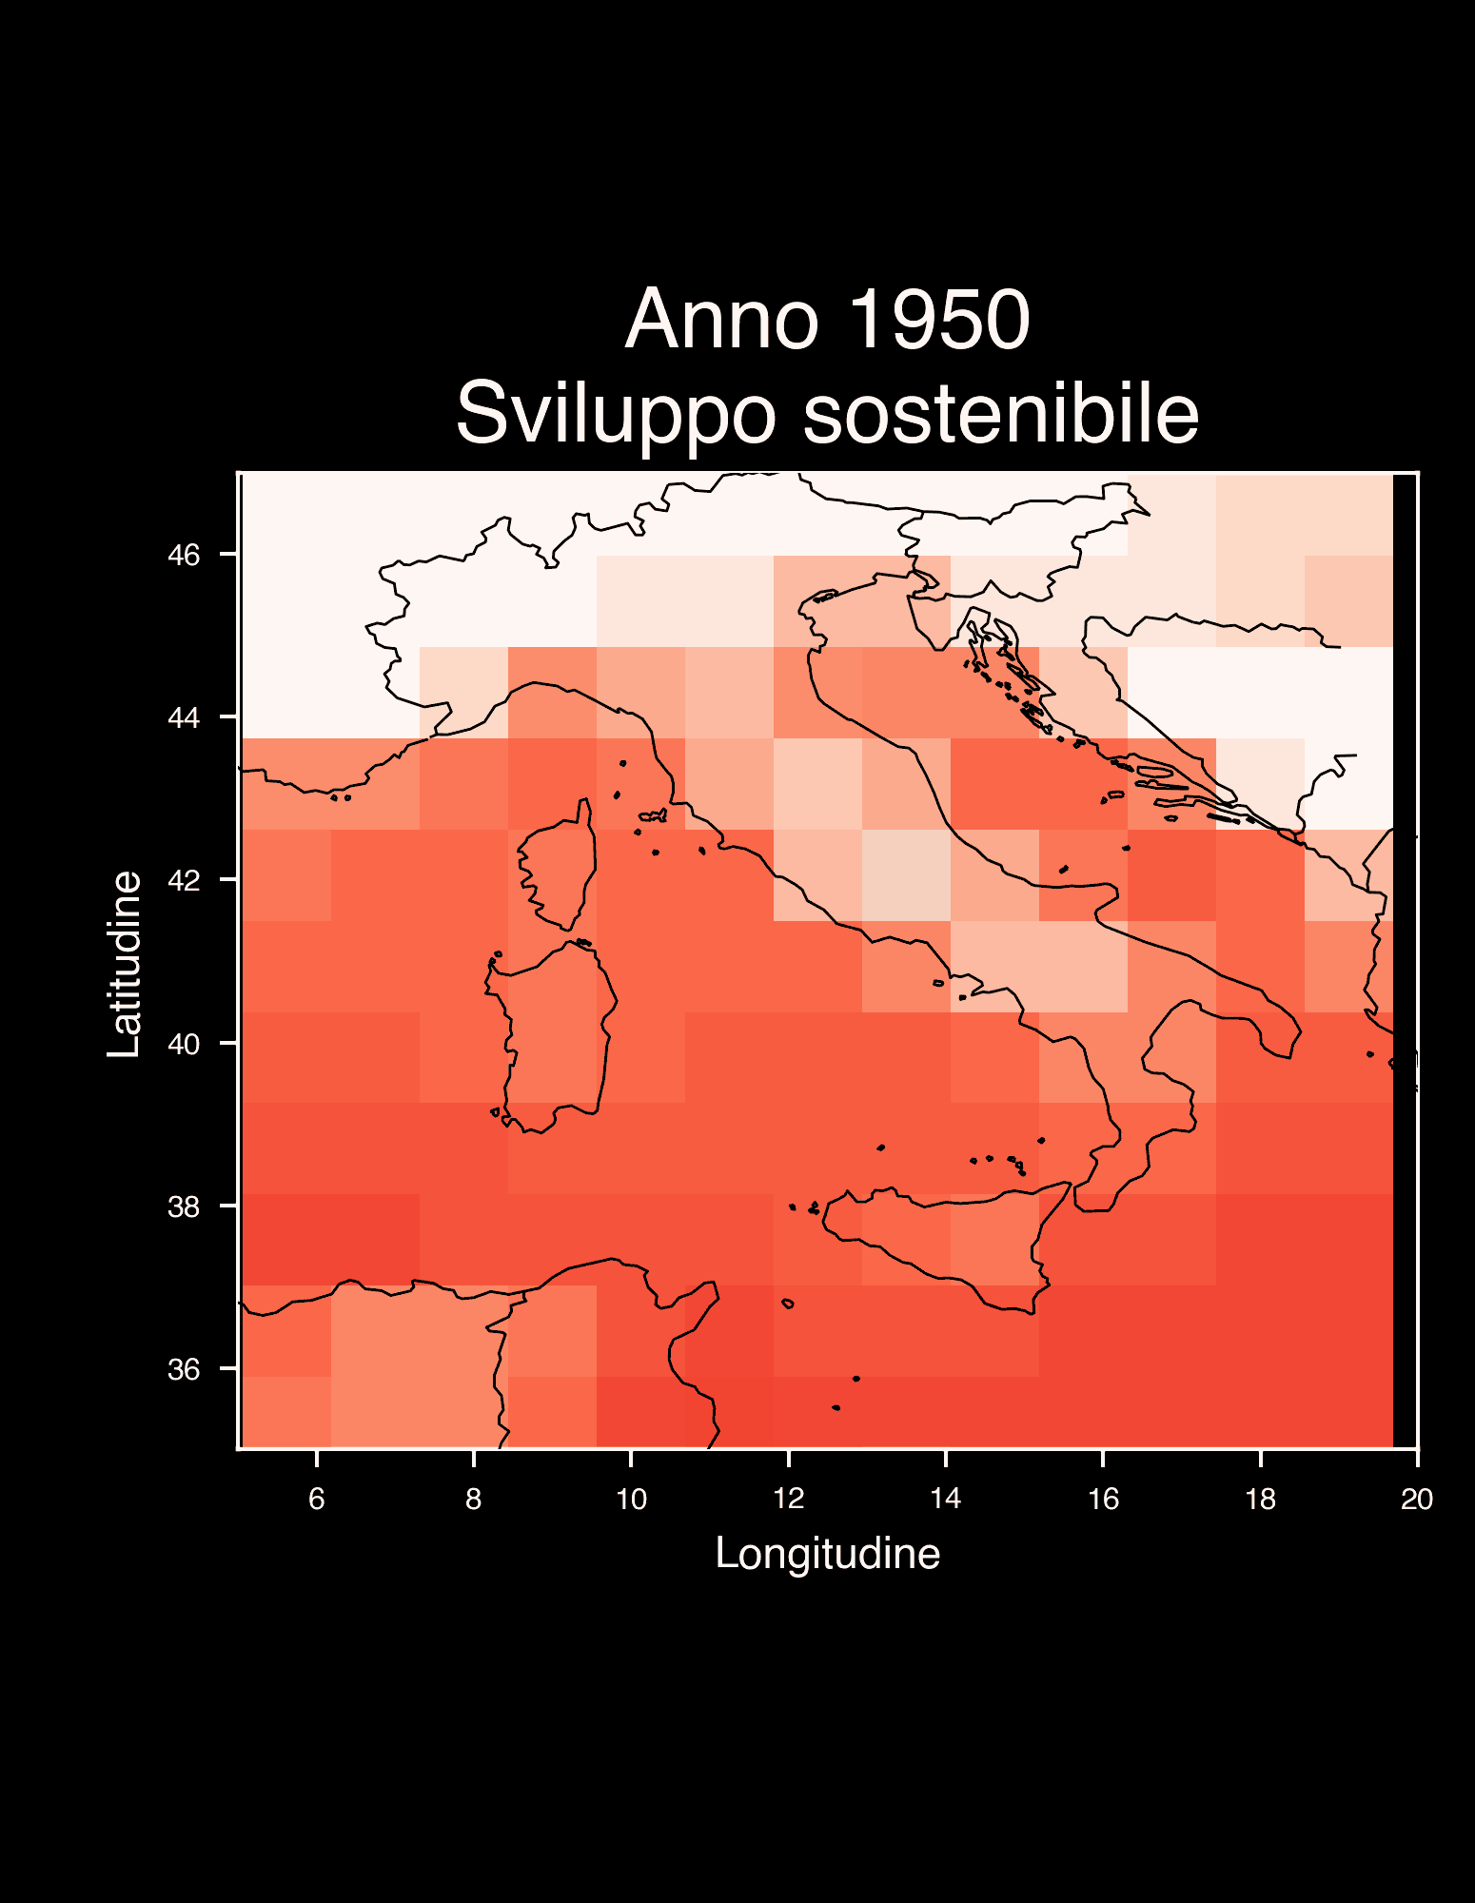
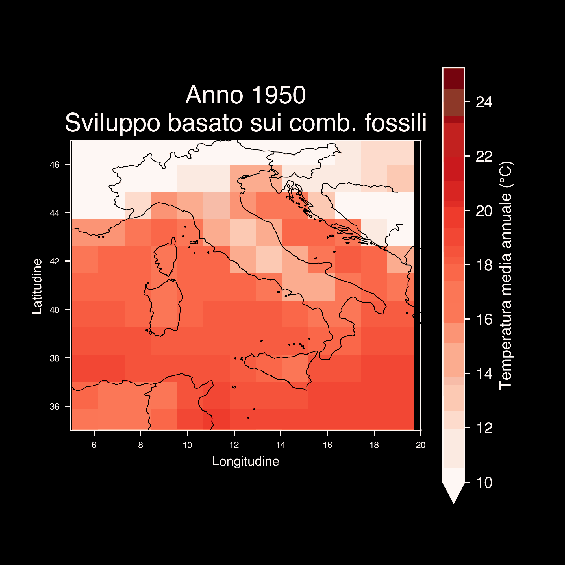

Slide 33
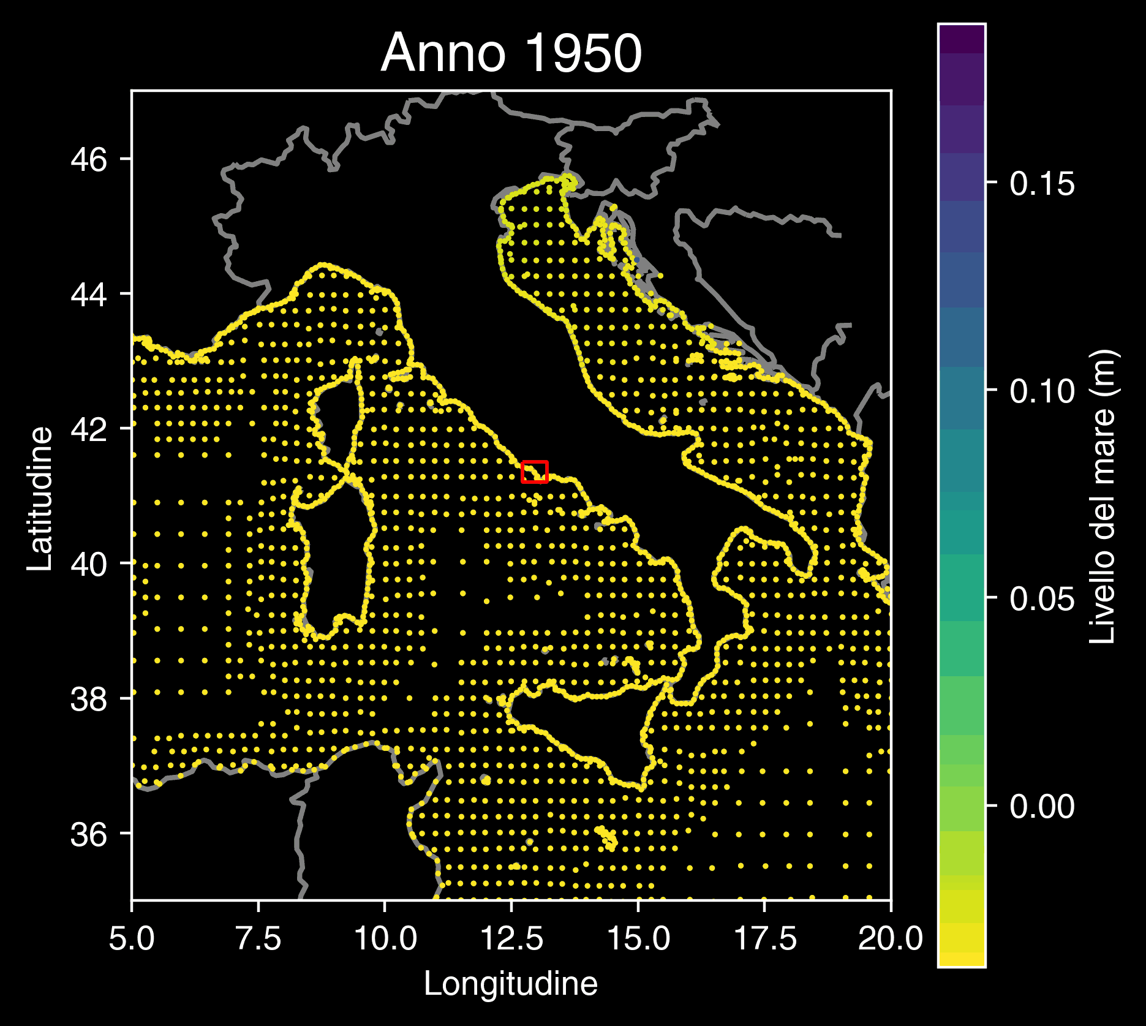
Copernicus Climate Change Service (2022): Global sea level change indicators from 1950 to 2050 derived from reanalysis and high resolution CMIP6 climate projections. Copernicus Climate Change Service (C3S) Climate Data Store (CDS). DOI: 10.24381/cds.6edf04e0

Slide 34
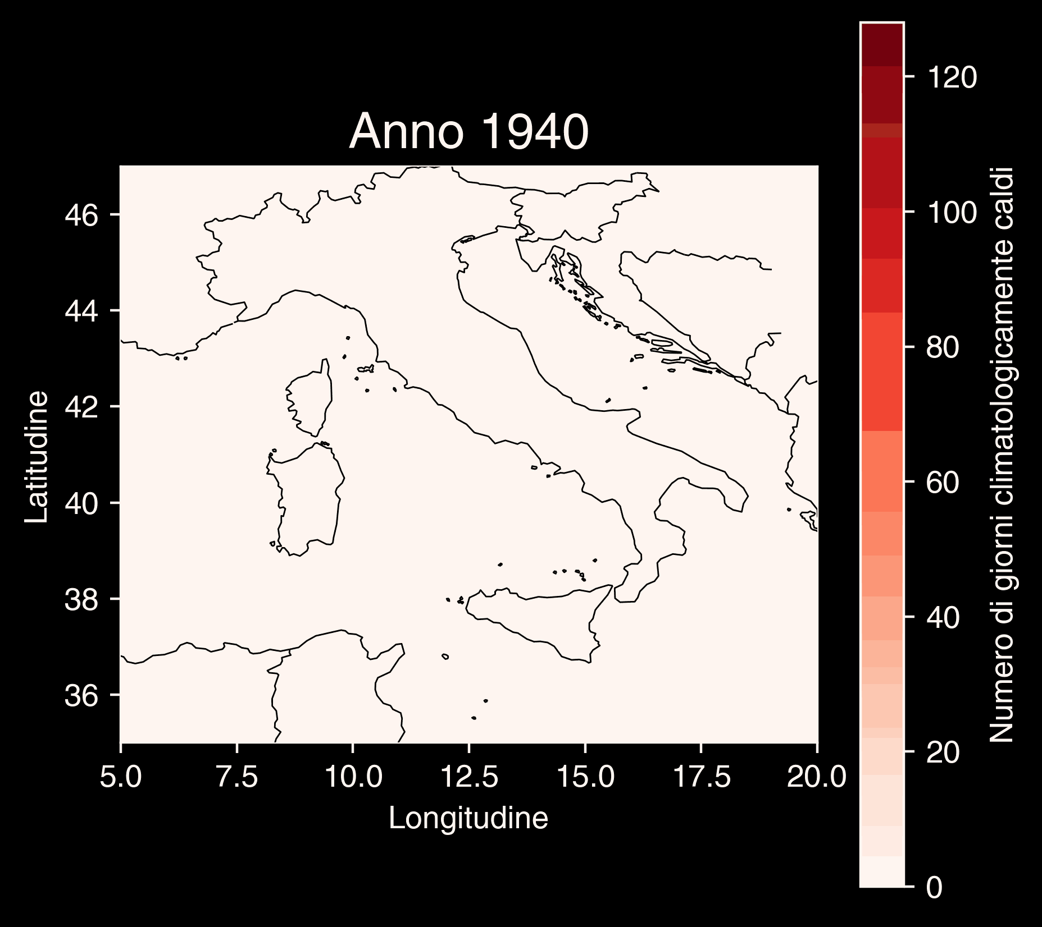
Copernicus Climate Change Service (C3S), Climate Data Store (CDS), (2024): Climate indicators for Europe from 1940 to 2100 derived from reanalysis and climate projections, Copernicus Climate Change Service (C3S) Climate Data Store (CDS).

Slide 35
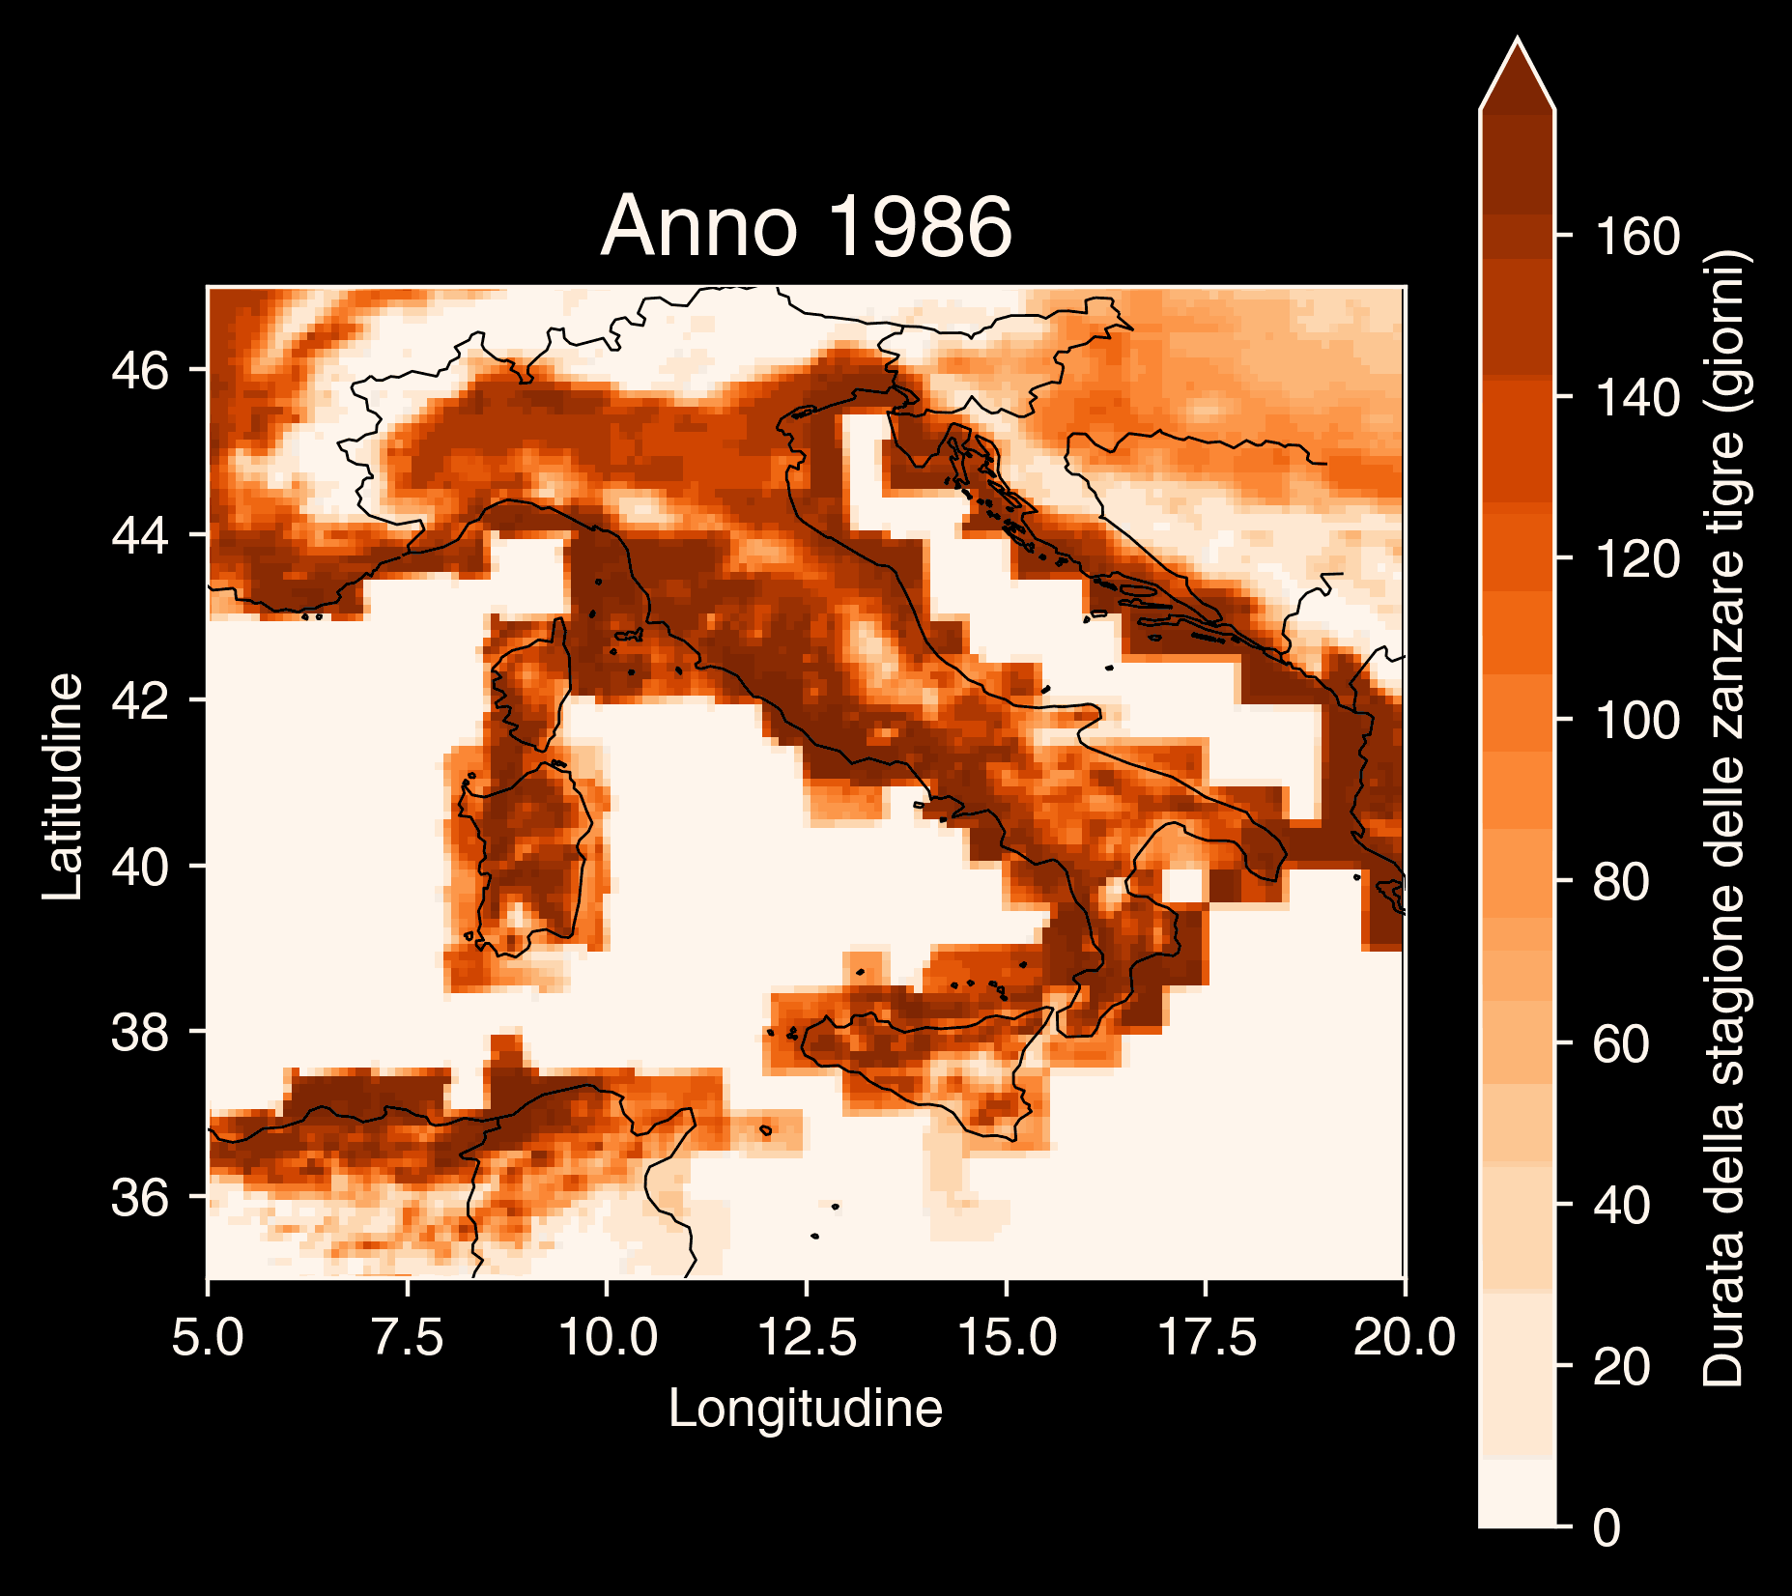
Copernicus Climate Change Service, Climate Data Store, (2019): Climatic suitability for the presence and seasonal activity of the Aedes albopictus mosquito for Europe derived from climate projections. Copernicus Climate Change Service (C3S) Climate Data Store (CDS). DOI: 10.24381/cds.d08ed09a

Slide 36

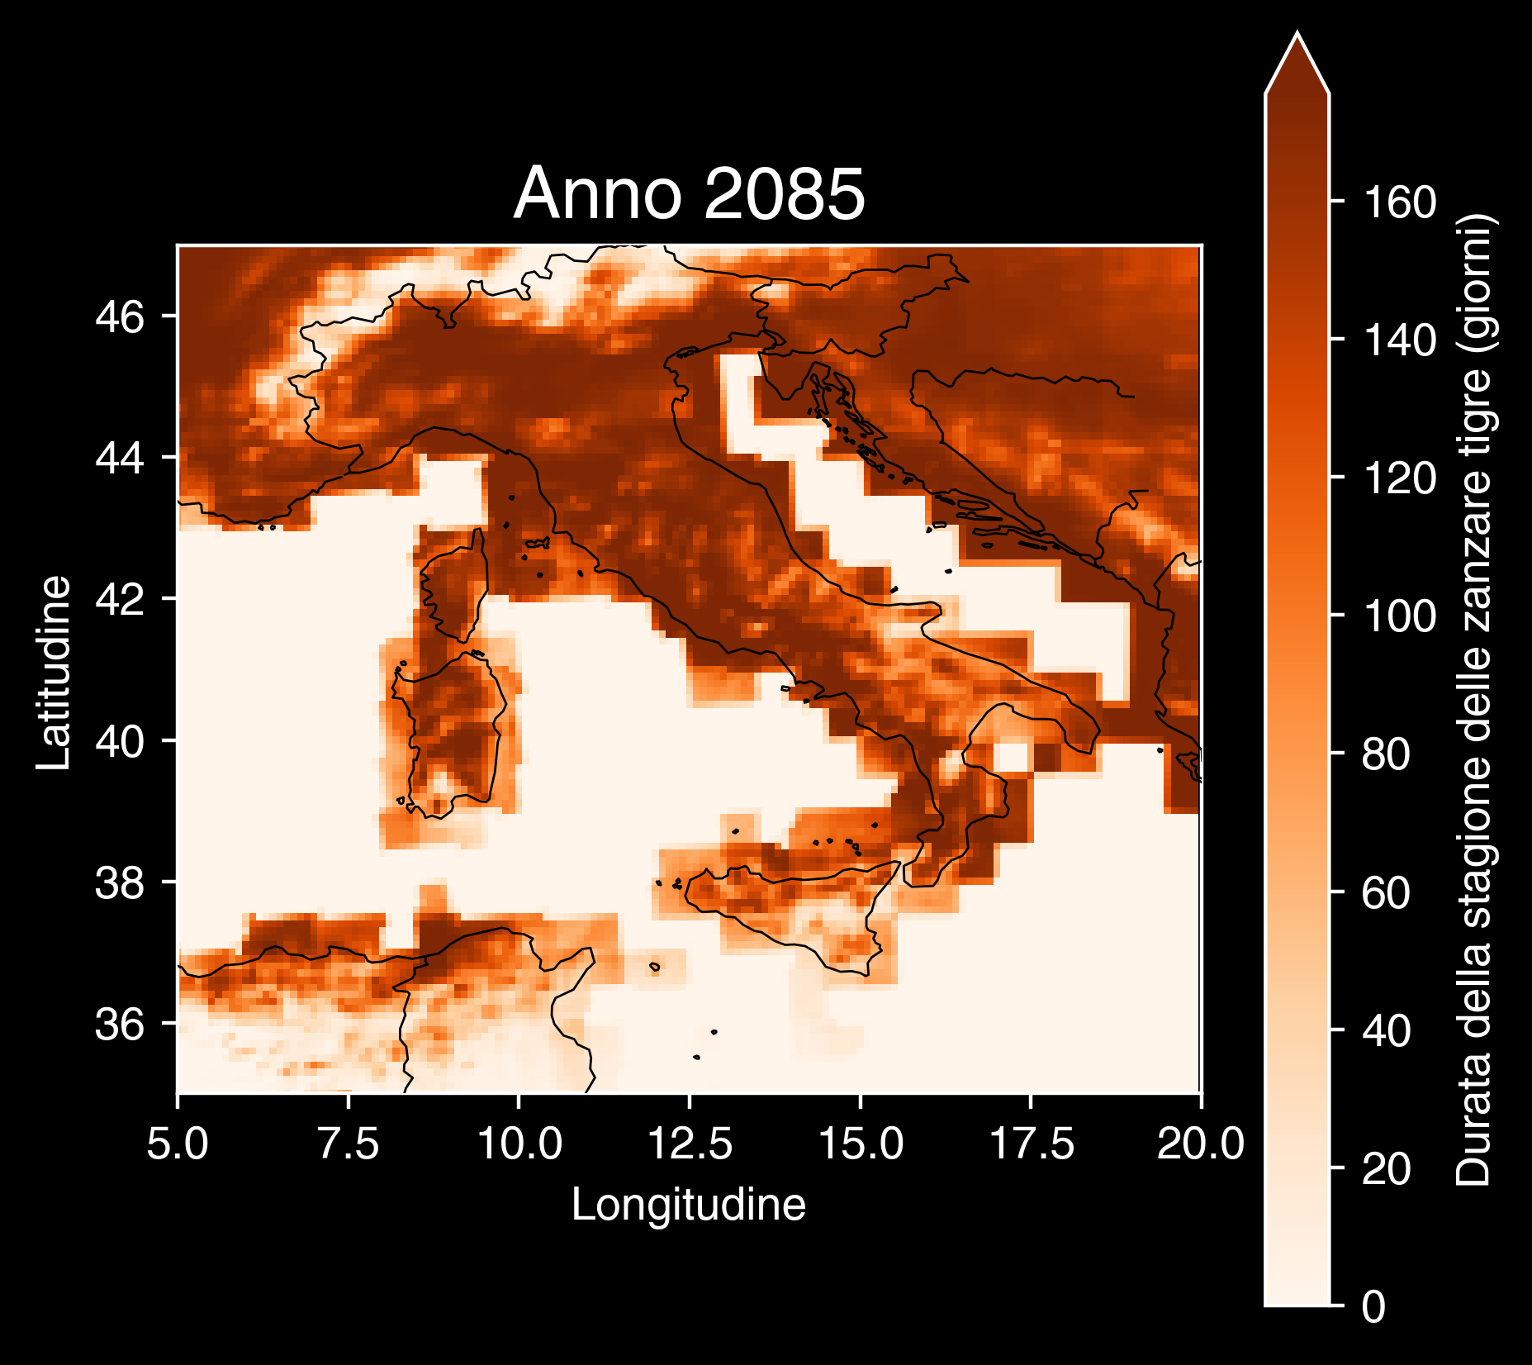
Copernicus Climate Change Service, Climate Data Store, (2019): Climatic suitability for the presence and seasonal activity of the Aedes albopictus mosquito for Europe derived from climate projections. Copernicus Climate Change Service (C3S) Climate Data Store (CDS). DOI: 10.24381/cds.d08ed09a

Slide 37
Le nostre scelte definiscono il cambiamento climatico

Slide 38
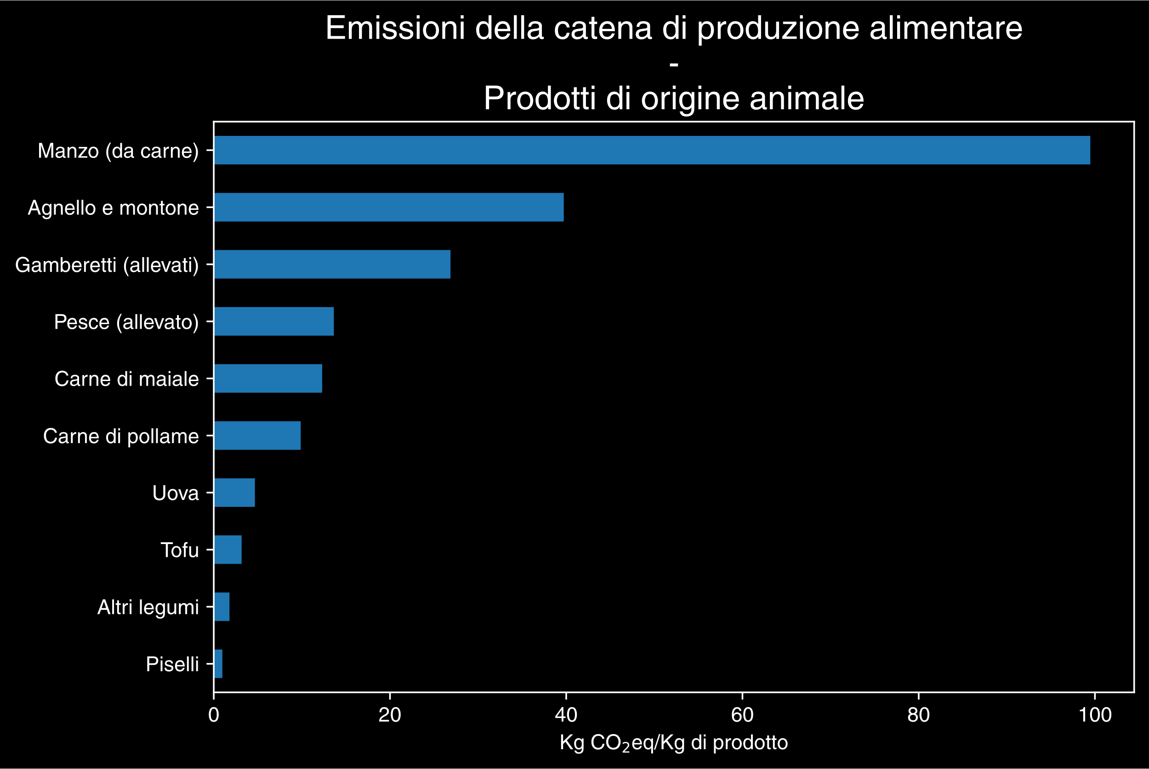
Hannah Ritchie, Pablo Rosado and Max Roser (2022) - “Environmental Impacts of Food Production” Published online at OurWorldinData.org. Retrieved from: 'https://ourworldindata.org/environmental-impacts-of-food' [Online Resource]

Slide 39
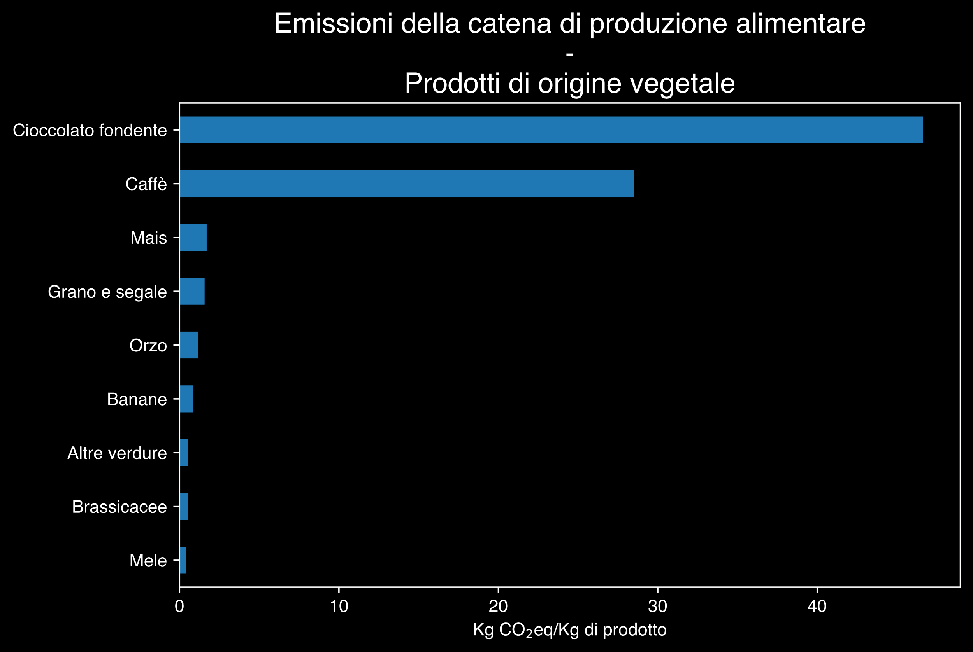
Hannah Ritchie, Pablo Rosado and Max Roser (2022) - “Environmental Impacts of Food Production” Published online at OurWorldinData.org. Retrieved from: 'https://ourworldindata.org/environmental-impacts-of-food' [Online Resource]

Slide 40
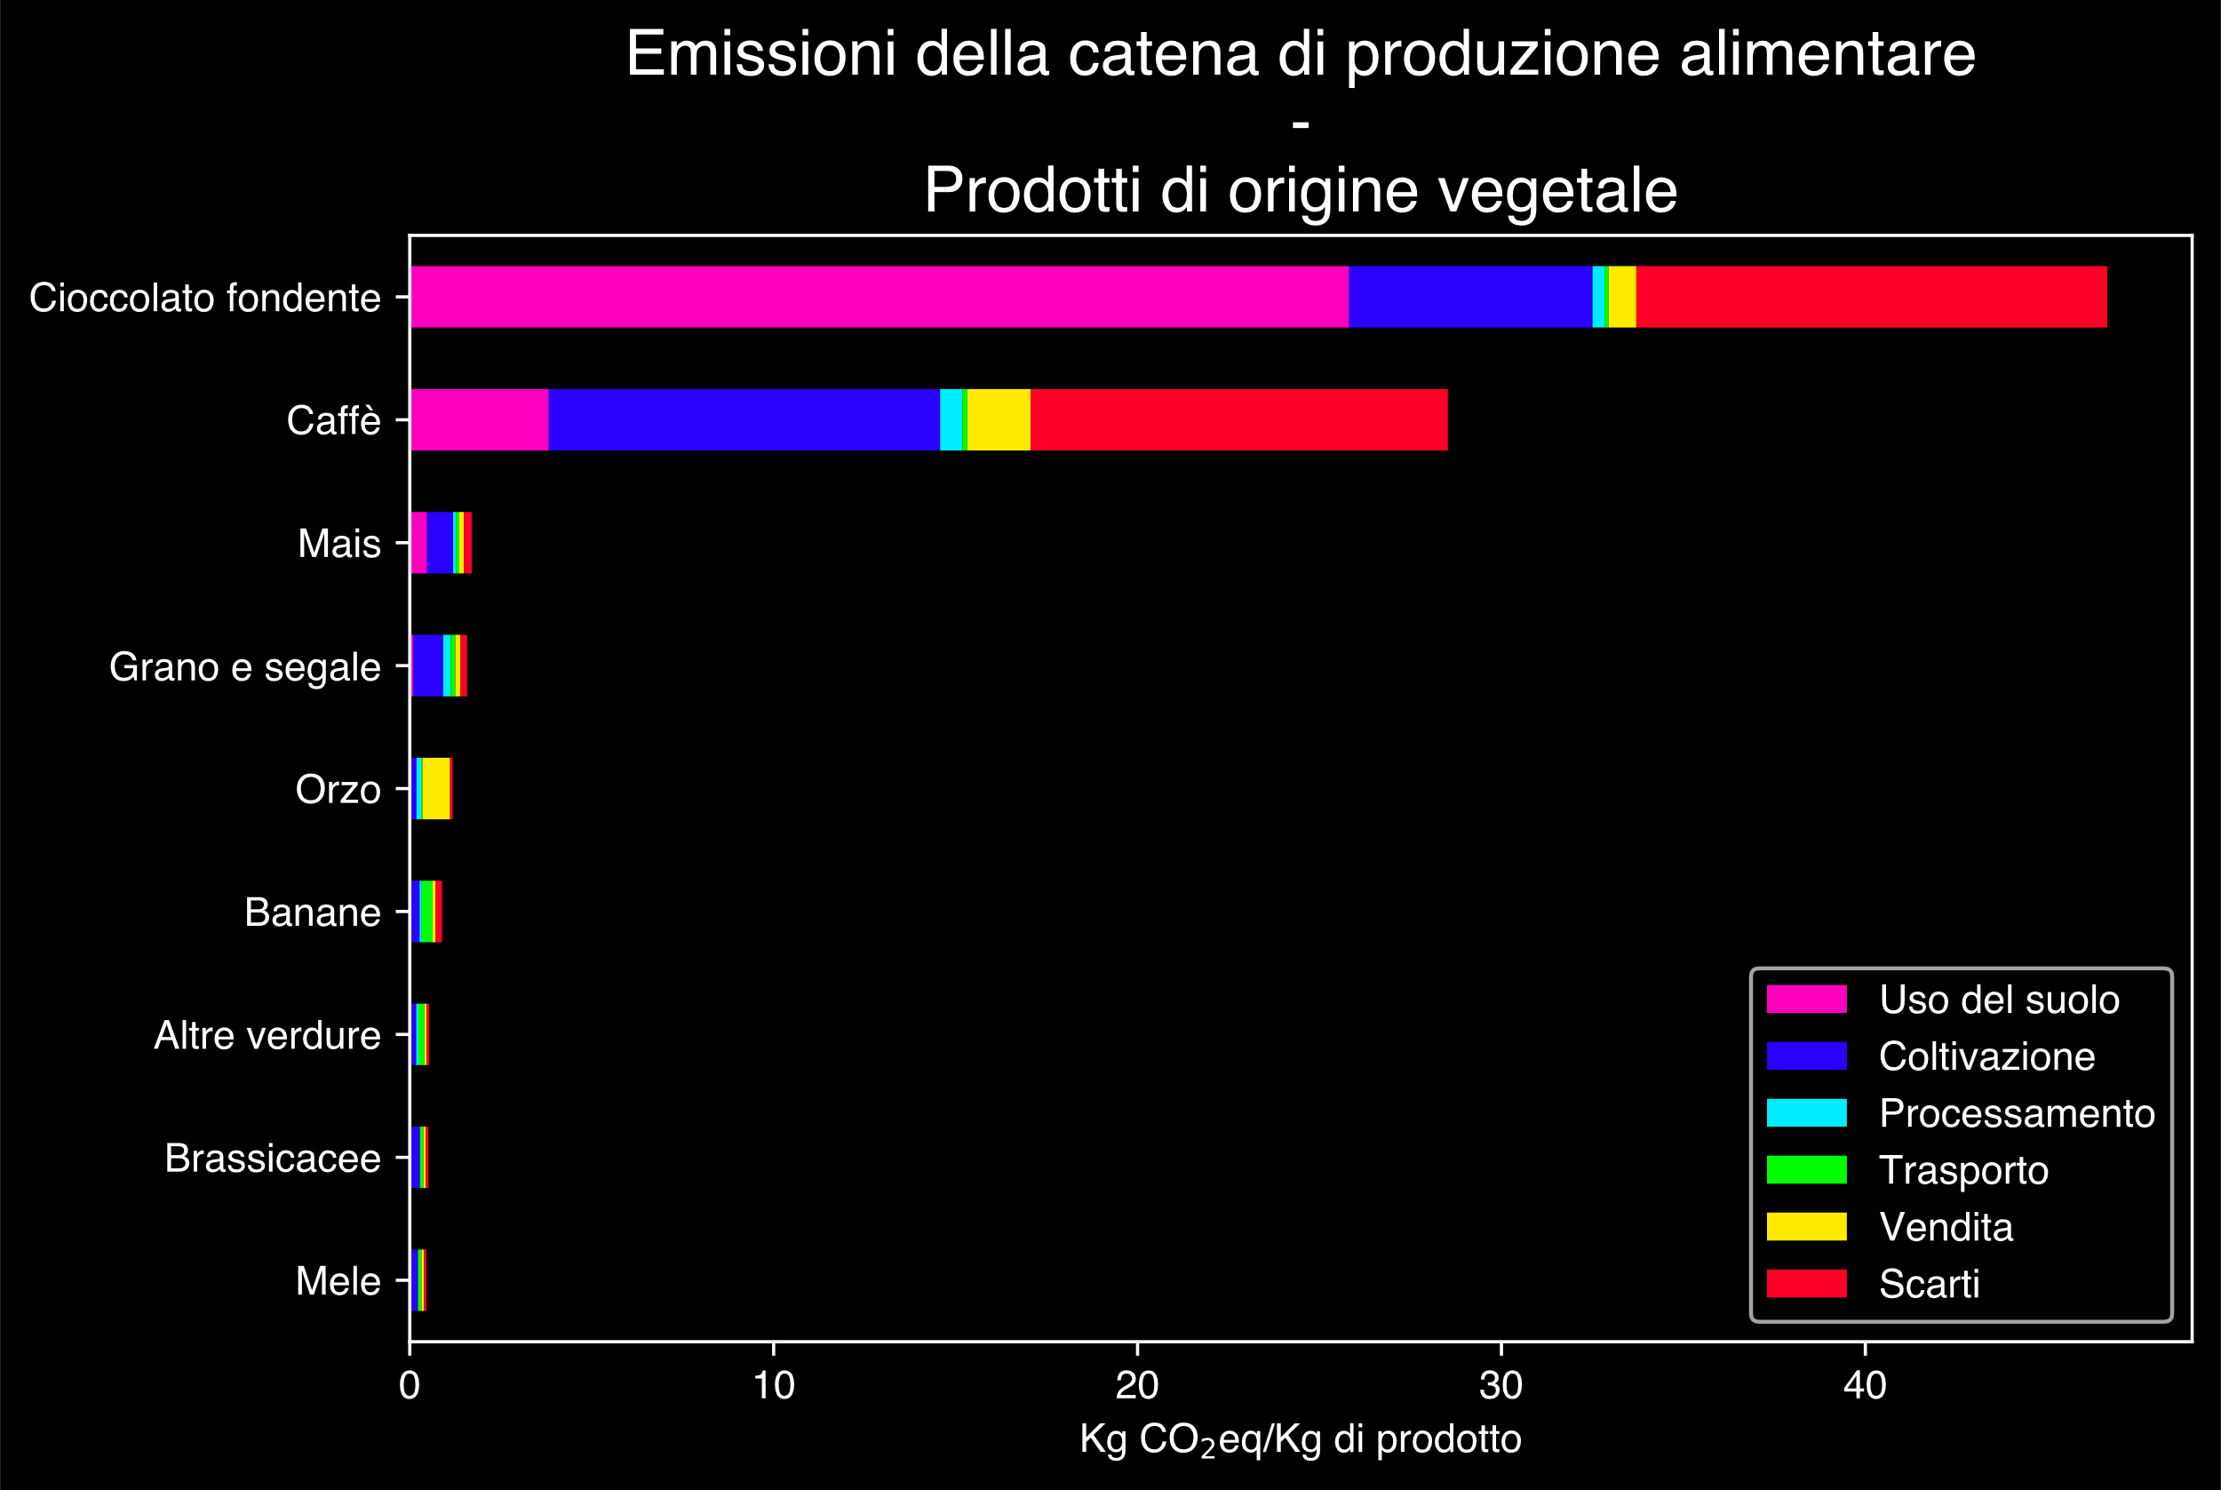
Hannah Ritchie, Pablo Rosado and Max Roser (2022) - “Environmental Impacts of Food Production” Published online at OurWorldinData.org. Retrieved from: 'https://ourworldindata.org/environmental-impacts-of-food' [Online Resource]

Slide 41
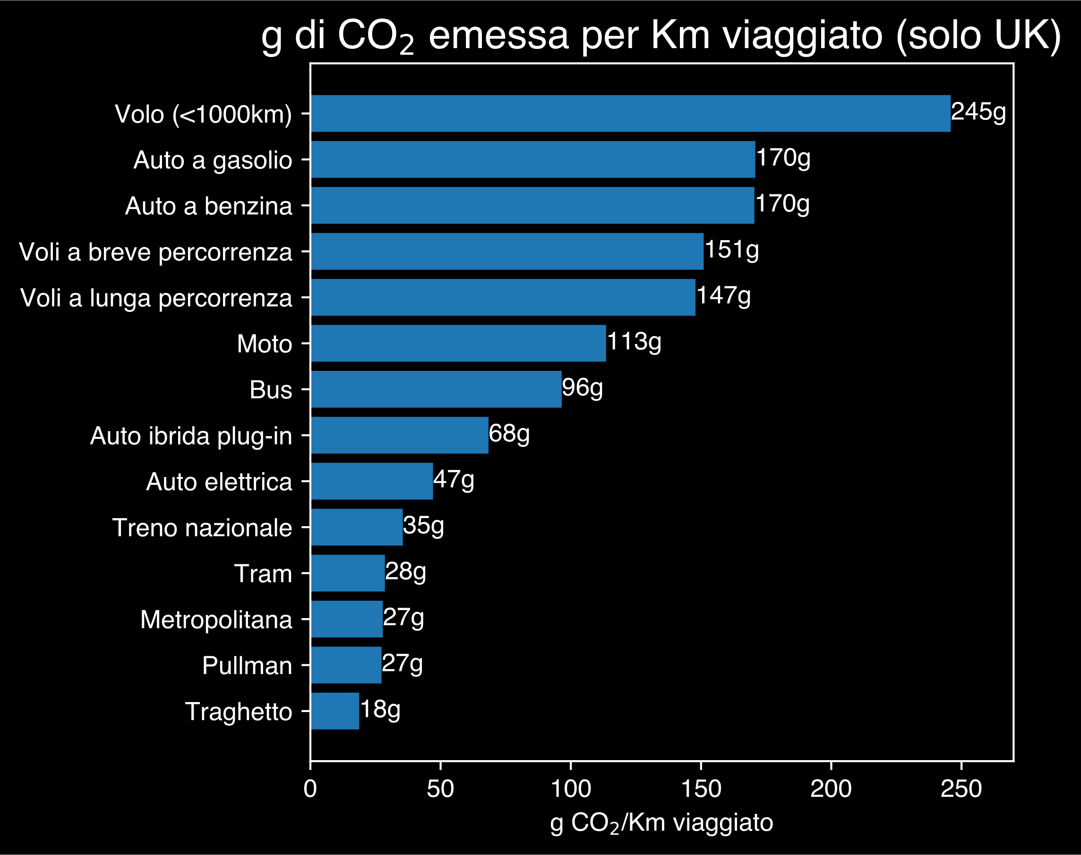
Hannah Ritchie (2023) - “Which form of transport has the smallest carbon footprint?” Published online at OurWorldinData.org. Retrieved from: 'https://ourworldindata.org/travel-carbon-footprint' [Online Resource]

Slide 42
Si può ancora fare di più
🧑‍🚒Segui la Protezione Civile del tuo territorio.
🗳️Ricorda l’importanza del tuo voto.
🛡️Preparati per adattarti al nuovo clima.

Slide 43
Fronteggiare il cambiamento climatico significa fronteggiare il futuro di ciascuno di noi

Slide 44

https://github.com/Robin-Castellani/pyconit25-future-climate-change

Slide 45
Feedback QR code

